Slide 1
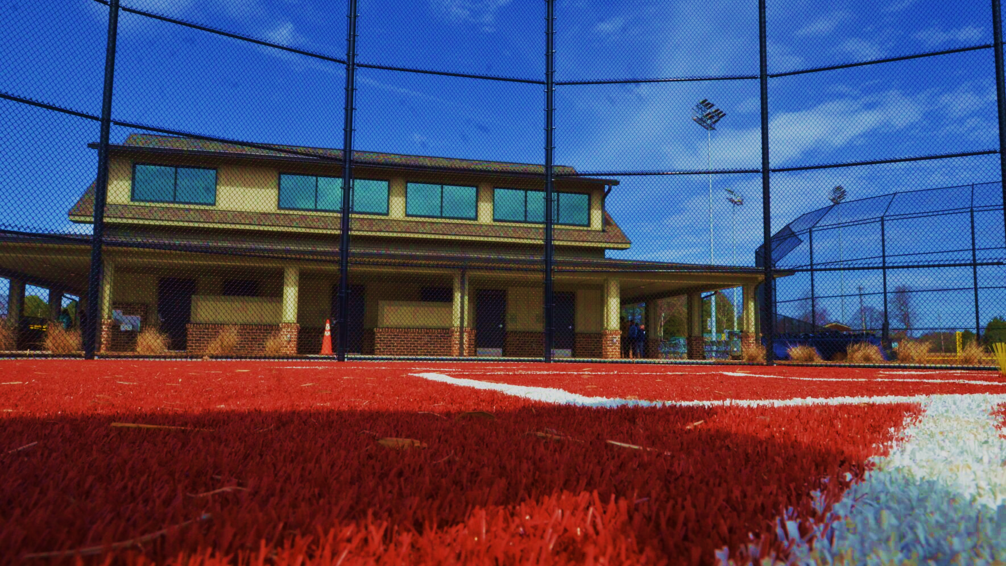

PERFECT GAME OVERVIEW.
STATESVILLE, NORTH CAROLINA

Slide 2
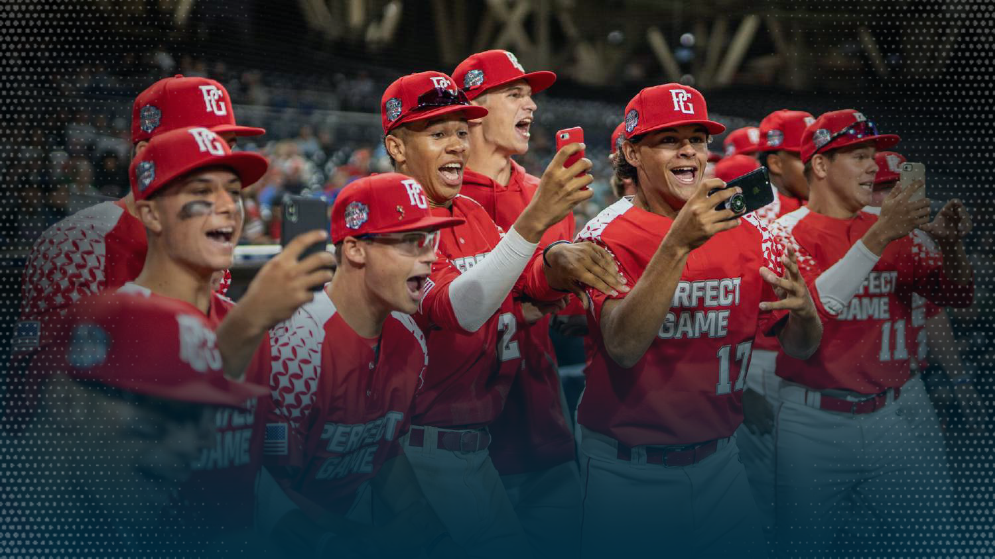

IS THE WORLD’S PREMIER YOUTH DIAMOND SPORTS PLATFORM.
OVERVIEW | 2025

Slide 3


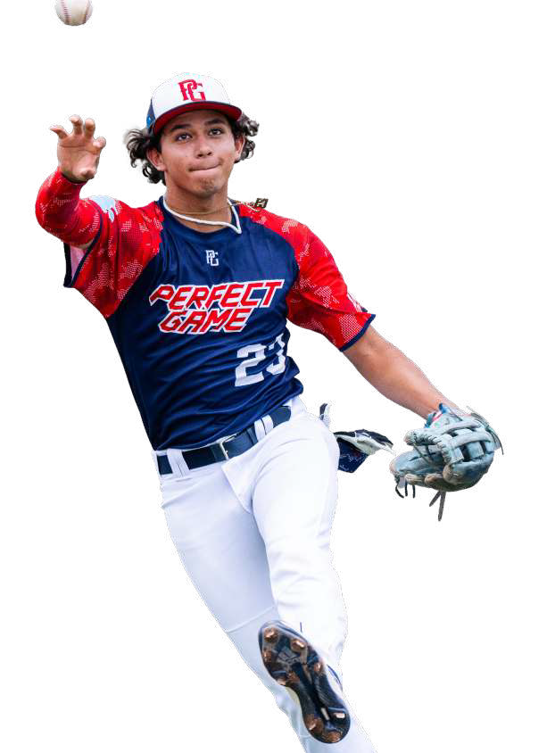

NEXTGEN
THE GAME’S NEXT
GENERATION PLAYS
PERFECT GAME
310K+
COLLEGE COMMITMENTS
15,033
PLAYERS DRAFTED
2,152
PG PLAYERS MADE THEIR MLB DEBUT
2M+
2025 PLAYER PARTICIPANTS

Slide 4




PGTV
SOCIAL
WEBSITE
DK +
37M
TOTAL VIEWS
825M
TOTAL VIEWS
340M
WEBSITE VIEWS
95K
DK GAMES SCORED
MEDIA
OUR REACH IS UNMATCHED
PERFECT GAME IS THE BIGGEST MEDIA ECOSYSTEM IN YOUTH BASEBALL & SOON TO BE SOFTBALL.
4.5M
LIVE EVENT VIEWS
3.5M
TOTAL FOLLOWERS
1M
DAILY VISITS
23M
DK WATCHES
13M
UNIQUE VIEWERS
65K
SUBSCRIPTIONS
82K
STREAMING HOURS
4

Slide 5
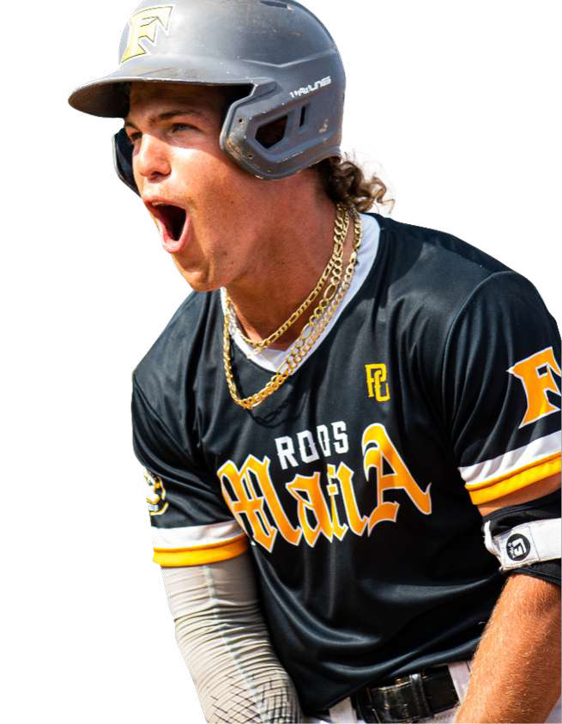



TIMELINE
THE EARLY DAYS
1995 1999 2001 2003 2018
Founded in 1995 in Cedar Rapids, Iowa, to showcase elite high school players who played their seasons after the MLB draft.
First PG profiles on the website.
First PG national showcase – first big time showcase event at MLB’s Tropicana Field, and still our premier showcase event for rising seniors.
First
Perfect game All-American classic.
Rick Thurman and
Rob Ponger assume ownership position of perfect game.

Slide 6


TIMELINE
BUILDING THE BRAND
2019 2020 2021 2022 2023 2024 2025
Expansion into youth business with key acquisitions: golf shores, Houston, Kansas city & Northeast.
Launch of PerfectGame.TV during the covid pandemic.
Rick Thurman and Rob Ponger purchase super majority position of perfect game.
Launched Diamondkast+ to include stats, video highlights, and live streaming.
Launched: PG branded products in 250+ dick's - apparel, headwear, gear, team uniforms. Dick’s becomes title sponsor of PG All-American classic.
Created a scalable brand platform with "believe in baseball" campaign. Expansion into Australia and Japan. Launched PG leagues. Sports drink Launch Hydrate, PG eyewear, rewards and loyalty program launched.
Perfect Game adds 31,000 youth teams through partnership with Upstate of South Carolina’s All League Baseball who are former USSSA & TopGun directors.

Slide 7



SPORTS FACILITIES COMPANIES (SFC) OVERVIEW & PERFECT GAME PARTNERSHIP PERFECT GAME

Slide 8











$$15 BILLION
SPORTS FACILITIES ADVISORY WAS
FOUNDED IN 2003
OUR MISSION
IMPROVE THE
IN PLANNED & FUNDED FACILITIES
HEALTH & ECONOMIC
VITALITY OF THE
COMMUNITIES
3000
COMMUNITIES
SERVED
30 MILLION
VISITS AT SFC VENUES
WE SERVE
Institutional Grade Financial Forecasting
Economic Impact Projections
Strategic Program Planning
Project Finance Support Services
Outsourced Management
National Network of Venues
Operational Efficiency and Effectiveness
THE SINGLE LARGEST SPORTS TOURISM NETWORK
www.thesfnetwork.com

Slide 9


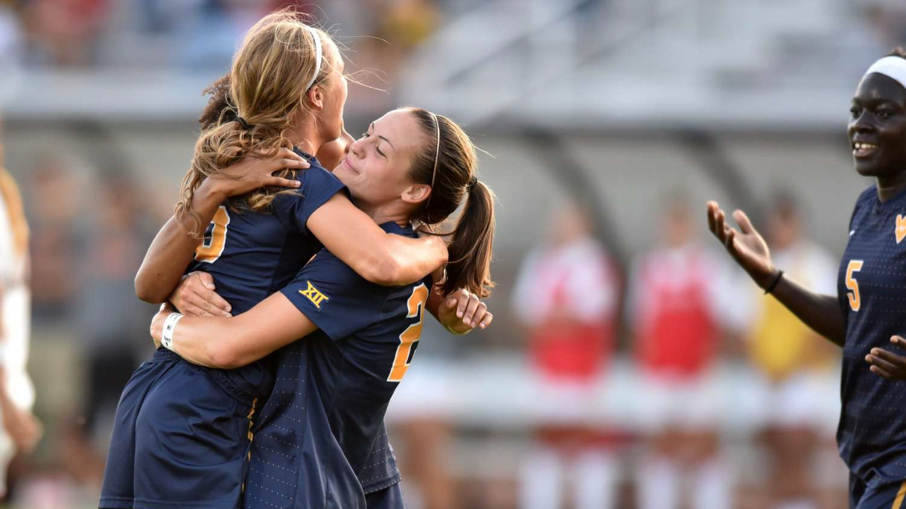

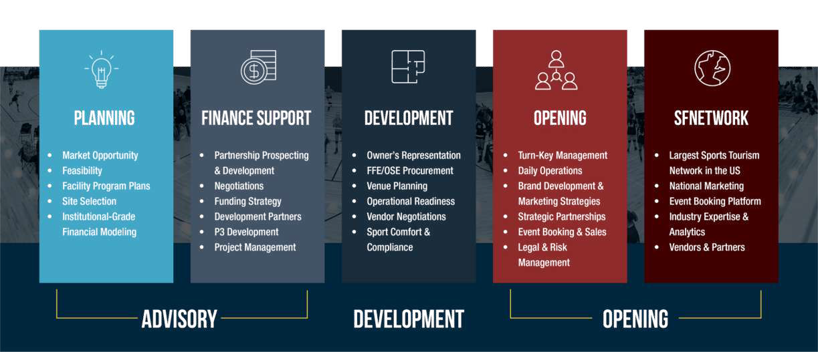
ADVISORY
DEVELOPMENT
MANAGEMENT

Slide 10
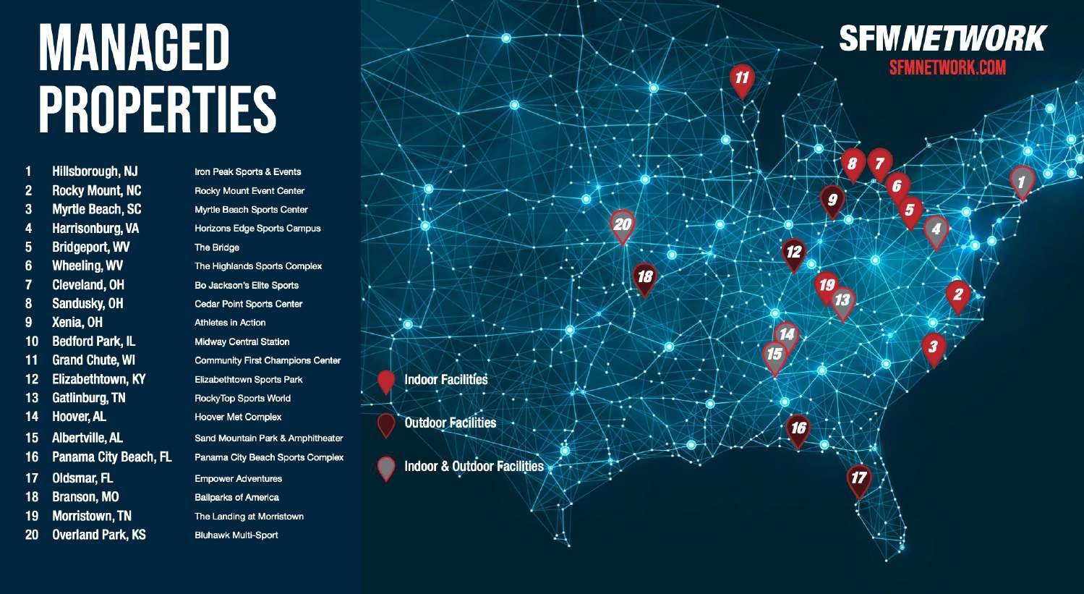


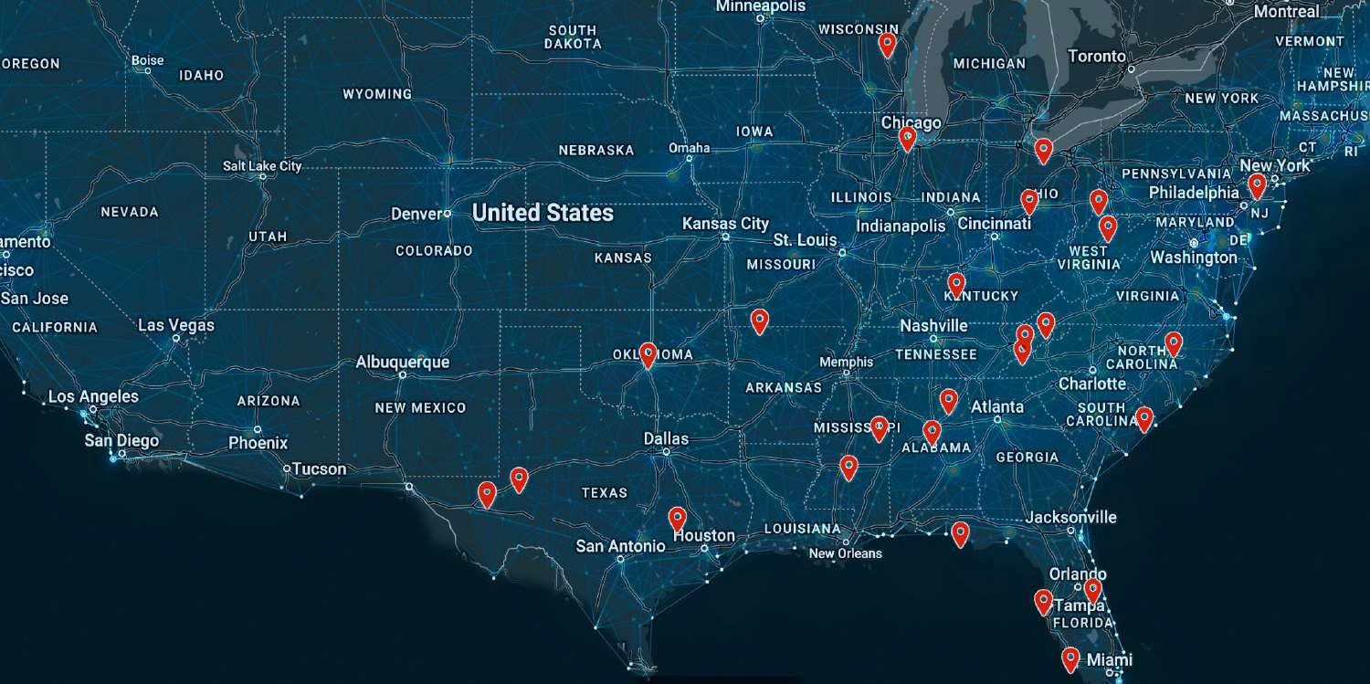





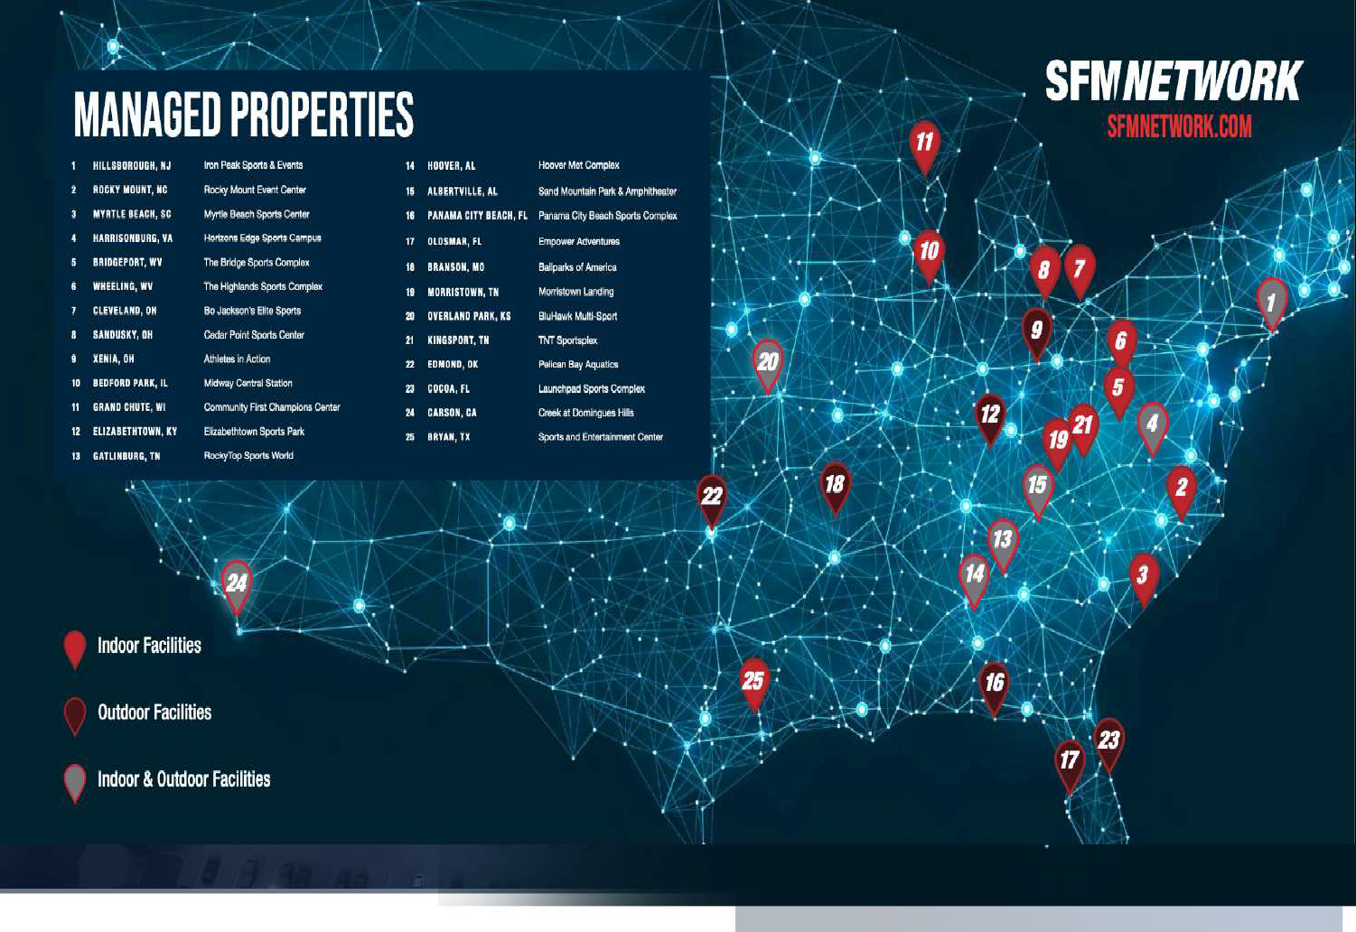












WWW.THESFNETWORK.COM
INDOOR FACILITIES
ROCKY MOUNT EVENT CENTER - ROCKY MOUNT. NC
MYRTLE BEACH SPORTS CENTER - MYRTLE BEACH. SC
THE BRIDGE SPORTS COMPLEX - BRIDGEPORT. WV
HIGHLANDS SPORTS COMPLEX - WHEELING, WV
CEDAR POINT SPORTS CENTER - SANDUSKY, OH
WINTRUST SPORTS COMPLEX - BEDFORD PARK, IL
MORRISTOWN LANDING - MORRISTOWN, IN
LEGENDS EVENT CENTER - BRYAN, TX
WEST MONROE SPORTS & EVENTS - WEST MONROE, LA
FORT BEND EPICENTER - FORT BEND. TX
OUTDOOR FACILITIES
INDOOR/ OUTDOOR FACILITIES
IRON PEAK SPORTS & EVENTS - HILLSBOROUGH, NJ
HORIZONS EDGE SPORTS CAMPUS - HARRISONBURG, VA
ROCKY TOP SPORTS WORLD - GATLINBURG, TN
HOOVER MET COMPLEX - HOOVER. AL
SAND MOUNTAIN PARK - ALBERTVILLE. AL
ADVENT HEALTH SPORTS PARK - OVERLAND PARK. KS
SCHEELS SPORTS PARK - SPRINGFIELD. IL
EMERALD ACRES SPORTS - MATTOON. IL
ARTESIA AQUATIC CENTER - ARTESIA. NM
BUENA VISTA SPORTS COMPLEX - LAREDO. TX
ALLISON SPORTS TOWN - SPRINGFIELD. MO
70 FACILITIES
+
IN MORE THAN 36 STATES ARE MANAGED BY SFC
AMERICA’S LARGEST NETWORK OF TOURNAMENT AND COMMUNITY BASED SPORTS DESTINATIONS

Slide 11

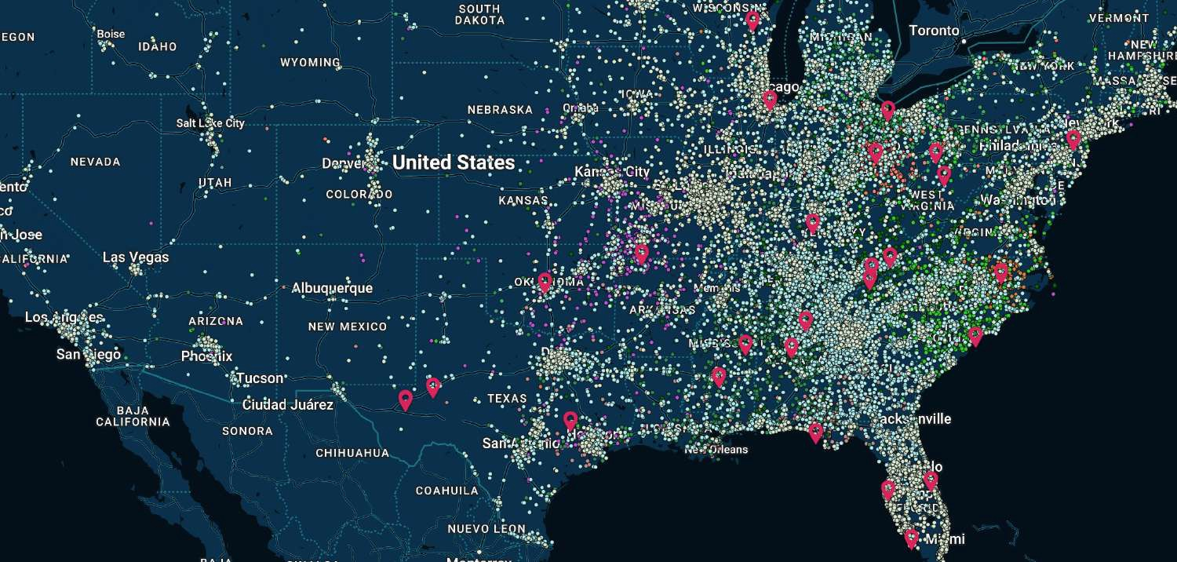
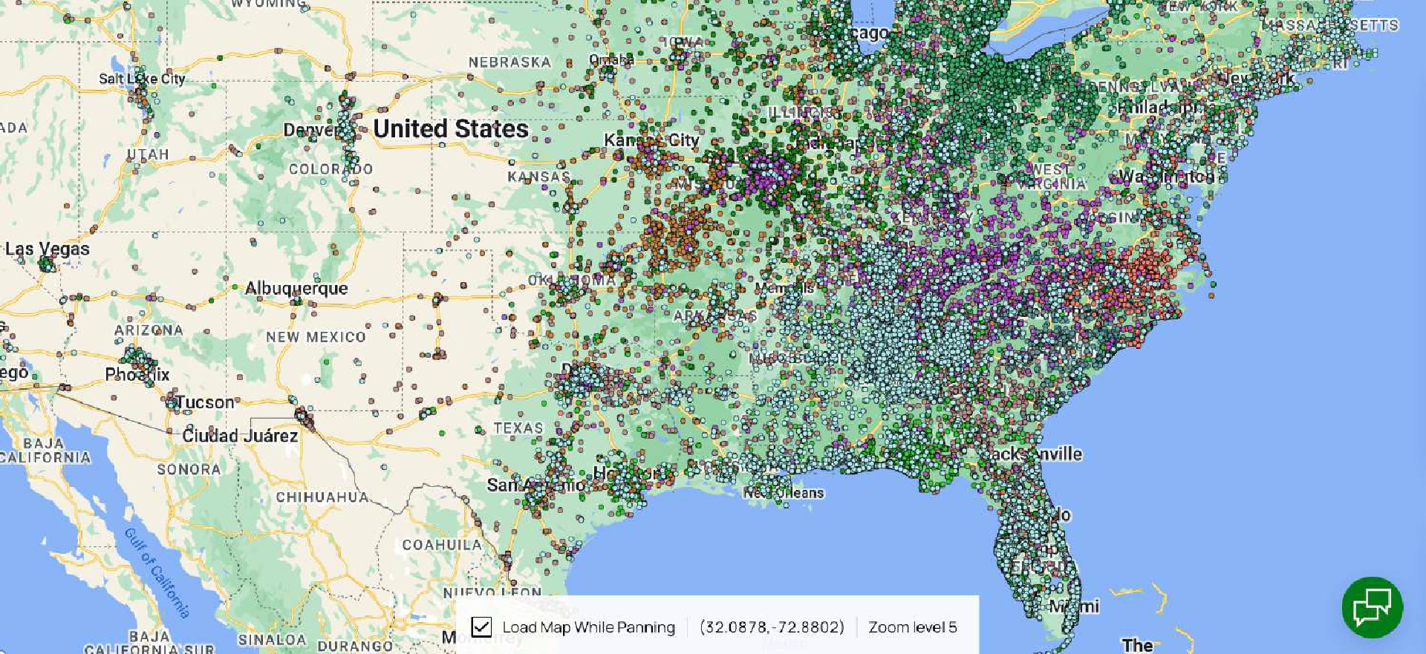

REGIONAL & NATIONAL AUDIENCE VISITATION TO THE SF NETWORK
SPORTS FACILITIES COMPANIES MOBILE DEVICE DATA
THE GREEN DOTS REPRESENT THE HOME LOCATIONS OF EXISTING AUDIENCE SEGMENTS THAT HAVE VISITED THE SF NETWORK’S PORTFOLIO OF VENUES
©2021 BUXTON | CONFIDENTIAL. FOR REFERENCE AND INFORMATIONAL PURPOSES ONLY
www. t h e s f n e t wo r k . c o m

Slide 12

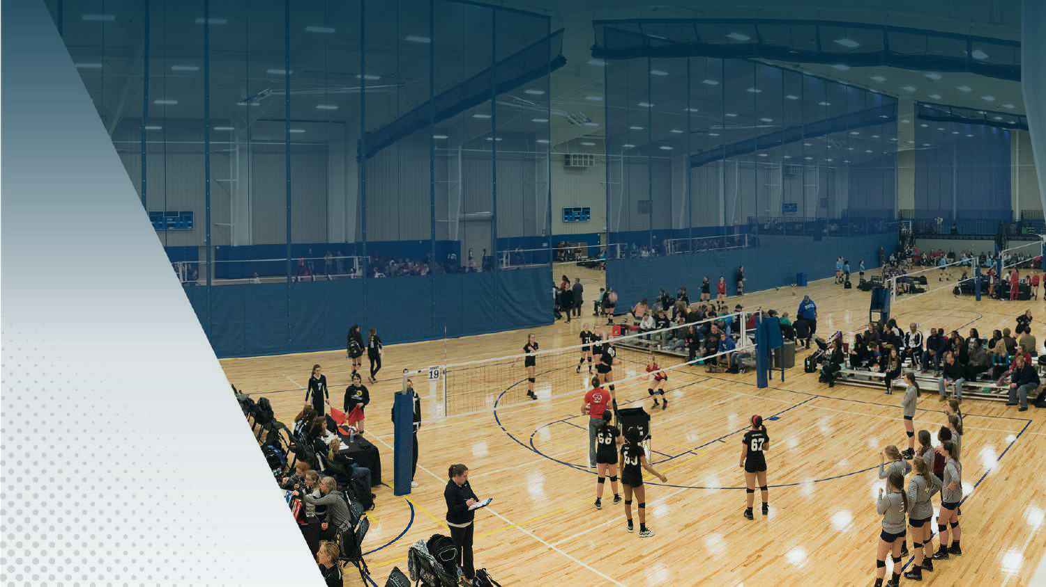


PERFORMANCE REPORT MYRTLE BEACH, SOUTH CAROLINA
YEAR OPENED: 2015
OWNERSHIP: CITY OF MYRTLE BEACH
FACILITY TYPE: INDOOR COURTS/EVENTS
DEVELOPMENT COST: $12.5 MILLION
PUBLICLY FUNDED * *
* INCLUDES BOTH DEVELOPMENT COSTS AND OPERATIONAL SUBSIDY
TOTAL ECONOMIC IMPACT: $230 MILLION+
ECONOMIC IMPACT (2024): $31.9 MILLION+
ROOM NIGHTS (2024): 60,000
HOTELS: LOCATED AT THE MYRTLE BEACH CONVENTION CENTER AND SHERATON HOTEL SITE. PURPOSE WAS TO FILL EXISTING HOTELS.
MY L B

Slide 13
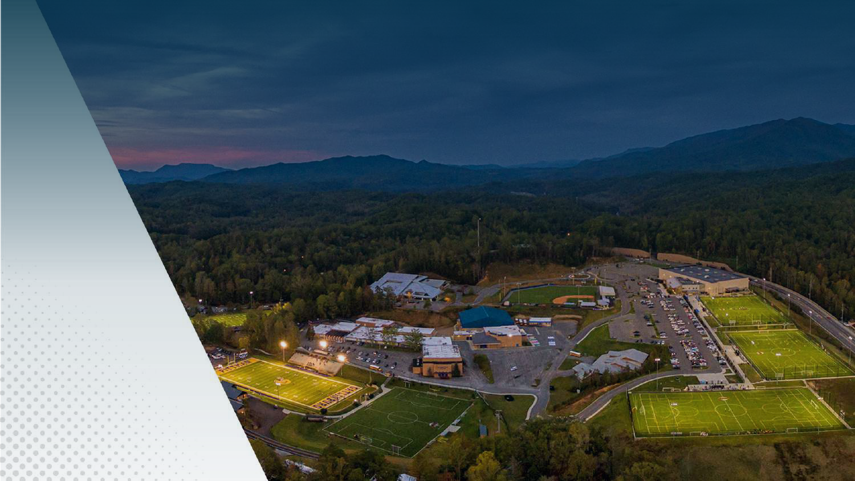

PERFORMANCE REPORT ROCKY TOP, TENNESSEE
YEAR OPENED: 2014
OWNERSHIP: CITY OF GATLINBURG/SEVIER COUNTY
FACILITY TYPE: INDOOR COURTS & OUTDOOR FIELDS
DEVELOPMENT COST: $23 MILLION
PUBLICLY FUNDED * *
* INCLUDES BOTH DEVELOPMENT COSTS AND OPERATIONAL SUBSIDY
TOTAL ECONOMIC IMPACT: $400 MILLION+
ECONOMIC IMPACT (2024): $80 MILLION+
ROOM NIGHTS (2024): 108,800
HOTELS: GOAL WAS TO FILL EXISTING HOTEL ROOMS. ADDITIONALLY, TWO NEW LIMITED-SERVICE HOTELS HAVE BEEN DEVELOPED AND OPENED SINCE FACILITY OPENED ITS DOORS.
MY L B

Slide 14
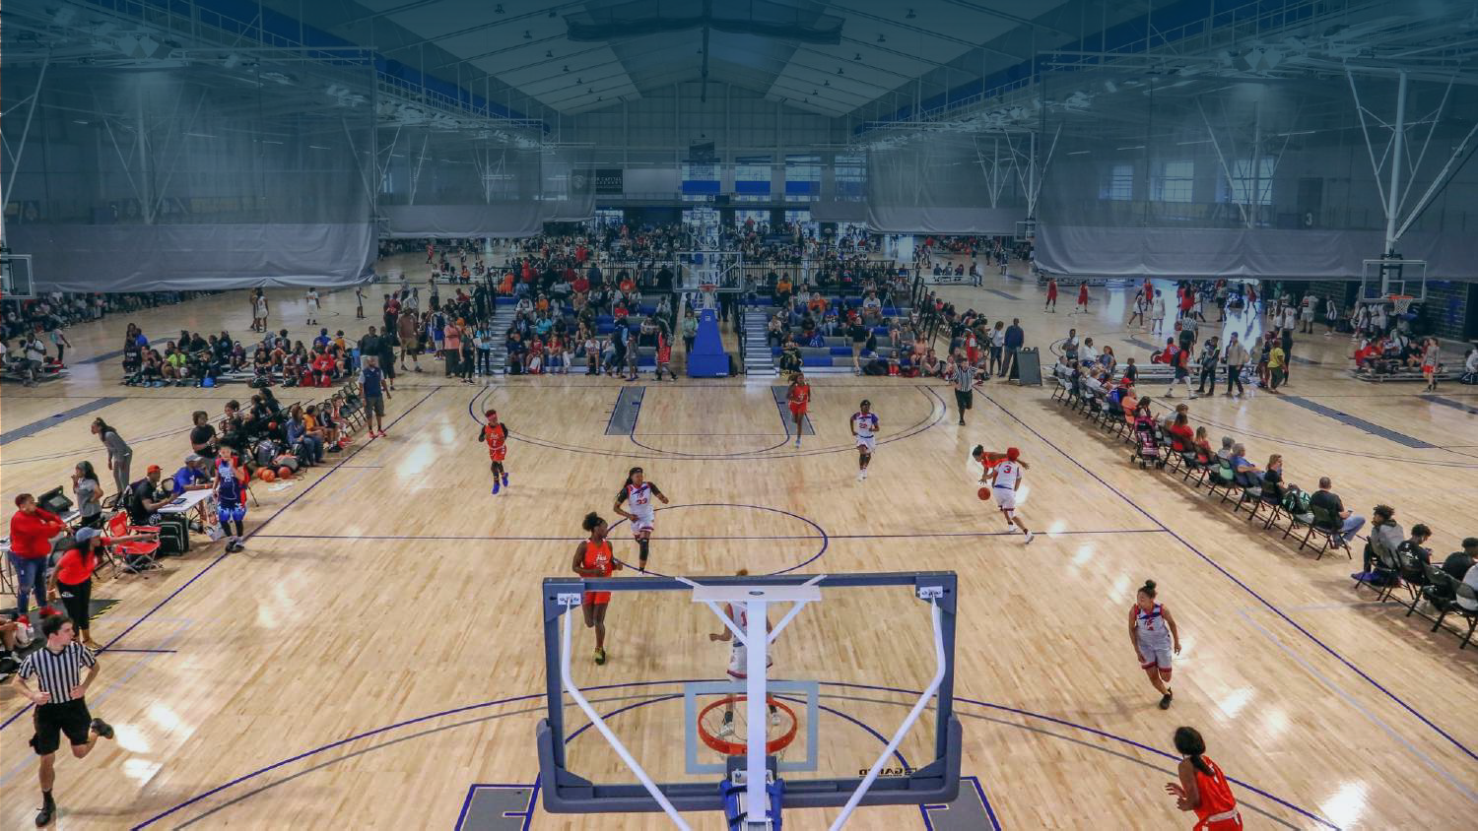


PERFORMANCE REPORT HOVER, ALABAMA
YEAR OPENED: 2017
OWNERSHIP: CITY OF HOOVER, ALABAMA
FACILITY TYPE: INDOOR COURTS & STADIUM/FIELDS
DEVELOPMENT COST: $80 MILLION
PUBLICLY FUNDED * *
* INCLUDES BOTH DEVELOPMENT COSTS AND OPERATIONAL SUBSIDY
TOTAL ECONOMIC IMPACT: $400 MILLION+
ECONOMIC IMPACT (2024): $91.3 MILLION+
ROOM NIGHTS (2024): 92,000
HOTELS: THIS VNUE PRODUCES OVERNIGHT HOTEL BOOKINGS THROUGHOUT THE HOVER/BIRMINGHAM MARKETPLACE.

Slide 15
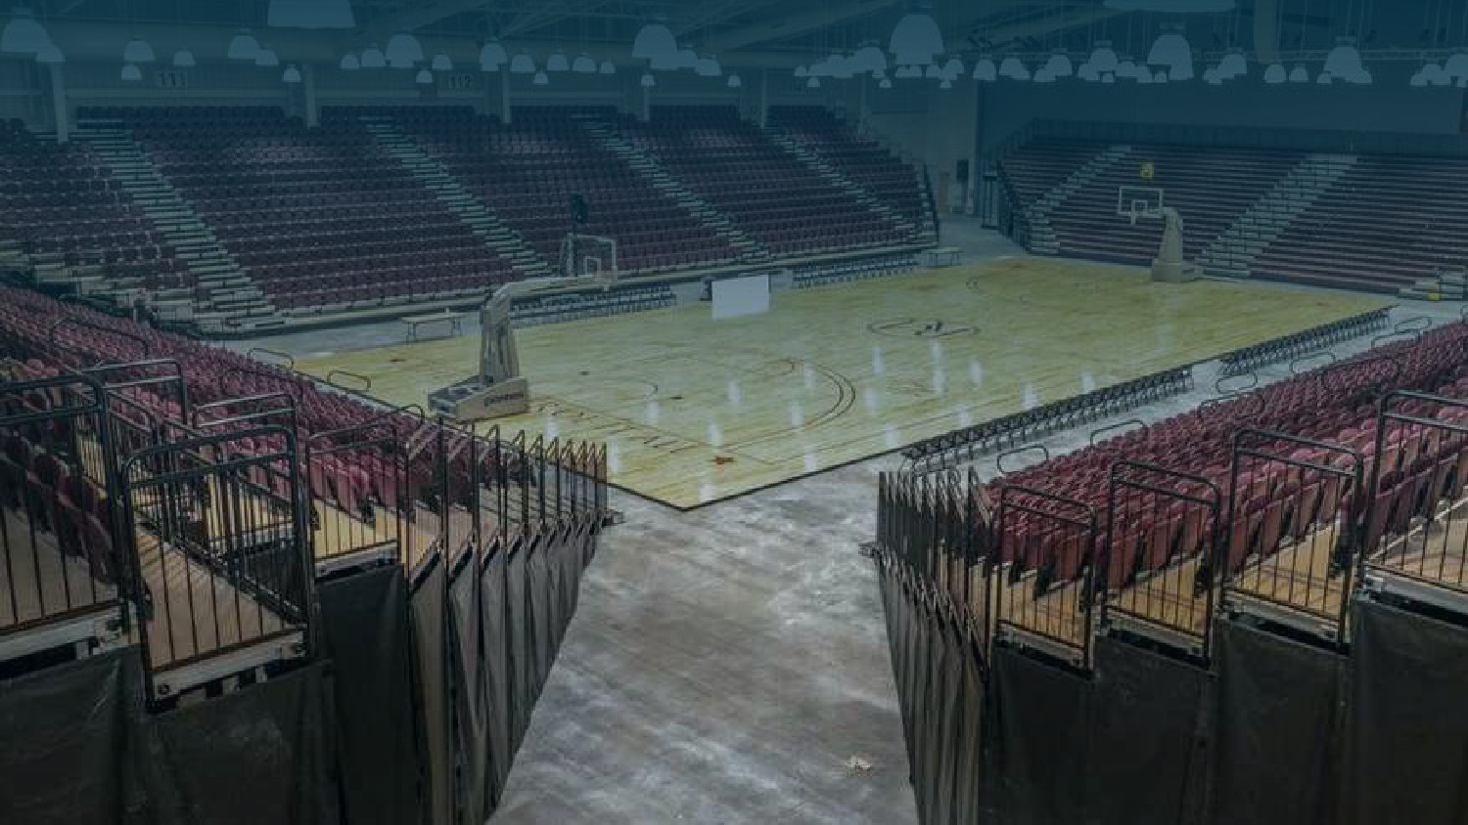


PERFORMANCE REPORT ROCKY MOUNT, NORTH CAROLINA
YEAR OPENED: 2018
OWNERSHIP: CITY OF ROCKY MOUNT, NC
FACILITY TYPE: INDOOR COURTS & EVENTS
DEVELOPMENT COST: $40 MILLION
PUBLICLY FUNDED * *
* INCLUDES BOTH DEVELOPMENT COSTS AND OPERATIONAL SUBSIDY
TOTAL ECONOMIC IMPACT: $76.5 MILLION+
ECONOMIC IMPACT (2024): $17.1 MILLION+
ROOM NIGHTS (2024): 29,410
HOTELS: NEW DOWNTOWN HOTELS DEVELOPED.

Slide 16

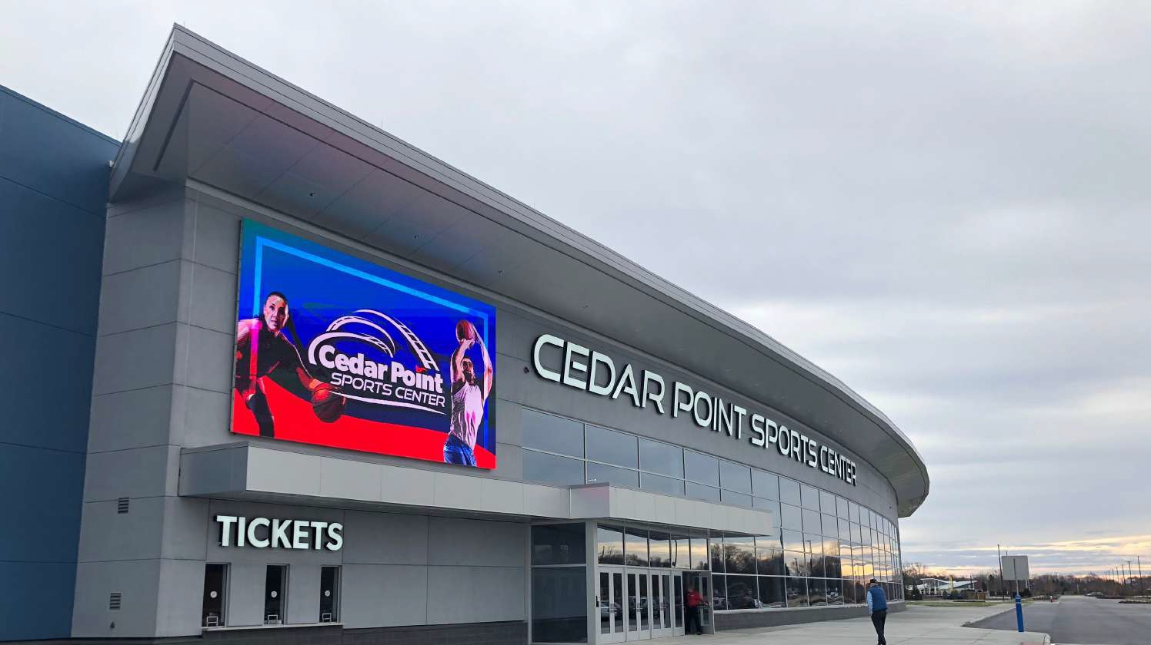

PERFORMANCE REPORT ROCKY MOUNT, NORTH CAROLINA
YEAR OPENED: 2020
OWNERSHIP: CEDAR FAIR
FACILITY TYPE: INDOOR COURTS & EVENTS
DEVELOPMENT COST: $42 MILLION
PUBLICLY FUNDED * *
* INCLUDES BOTH DEVELOPMENT COSTS AND OPERATIONAL SUBSIDY
TOTAL ECONOMIC IMPACT: $56 MILLION+
ECONOMIC IMPACT (2024): $22.7 MILLION+
ROOM NIGHTS (2024): 20,570
HOTELS: THE VENUE PRODUCES OVERNIGHT HOTEL BOOKINGS THROUGHOUT THE SANDUSKY REGIONAL MARKETPLACE.
MY L B

Slide 17
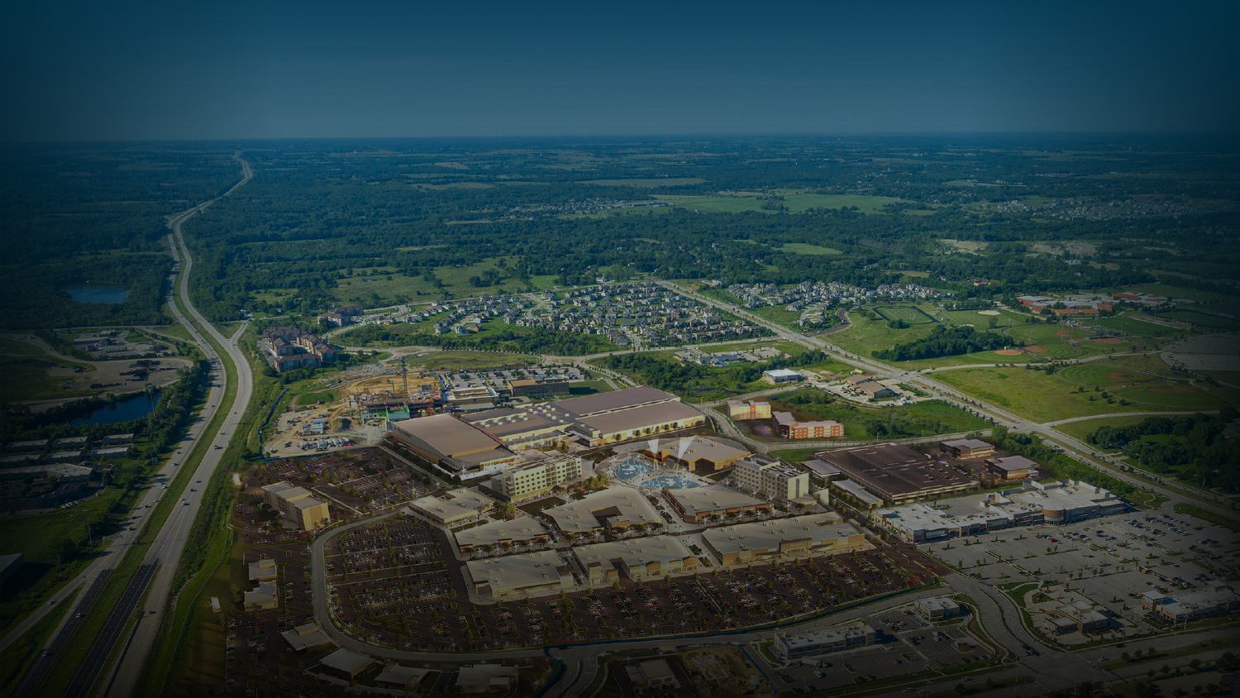



PERFORMANCE REPORT ROCKY MOUNT, NORTH CAROLINA
YEAR OPENED: 2024
OWNERSHIP: PRICE BROTHERS
FACILITY TYPE: INDOOR ICE/COURTS/EVENTS
DEVELOPMENT COST: $125.4 MILLION
PUBLICLY FUNDED * *
* INCLUDES BOTH DEVELOPMENT COSTS AND OPERATIONAL SUBSIDY
TOTAL ECONOMIC IMPACT: $22.3 MILLION+
ECONOMIC IMPACT (2024): TBD
PROJECTED ROOM NIGHTS (2024): 50,000
HOTELS: THE VENUE WILL SEE 816,000 VISITS AND PRODUCE SIGNIFICANT OVERNIGHT HOTEL STAYS THROUGHOUT THE KANSAS CITY MARKETPLACE.

Slide 18

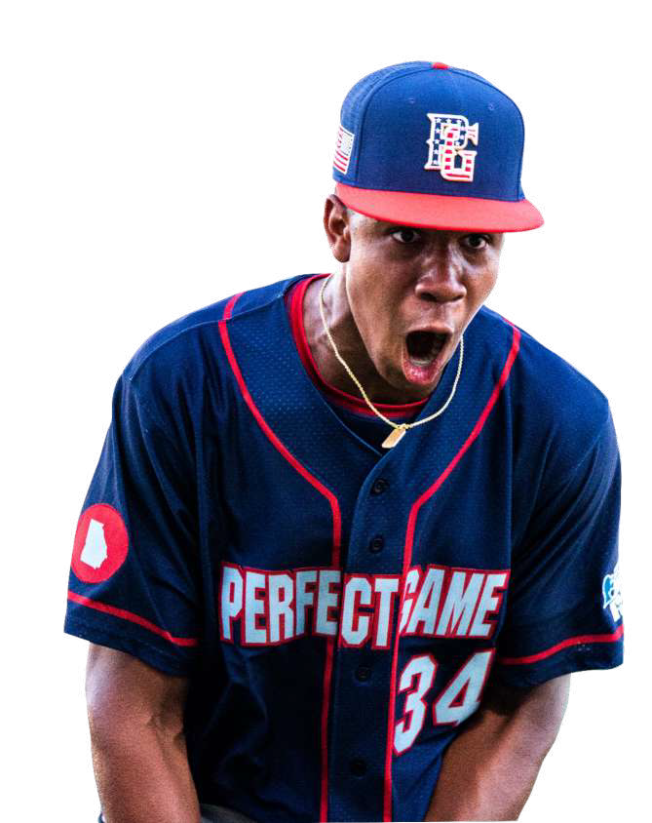



WHAT WE BELIEVE
WE BELIEVE

Slide 19



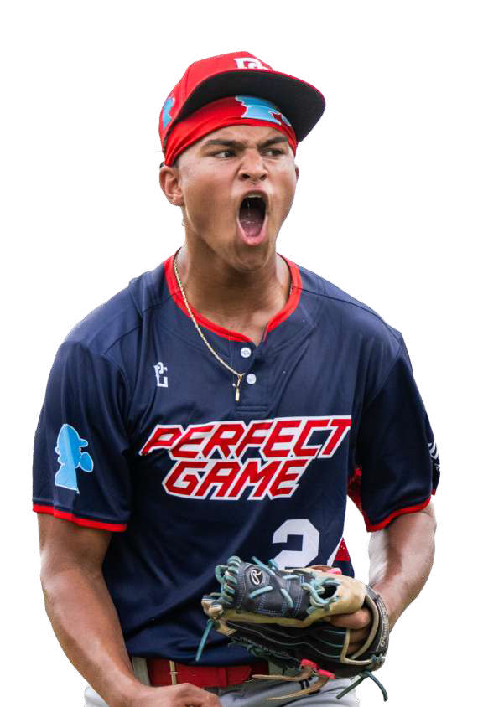

WE BELIEVE
AMERICA’S
PASTIME IS
NOW A GLOBAL GAME.
DIAMOND SPORTS ARE A BEACON OF AMERICAN CULTURE, BOTH DOMESTICALLY AND ABROAD.

Slide 20


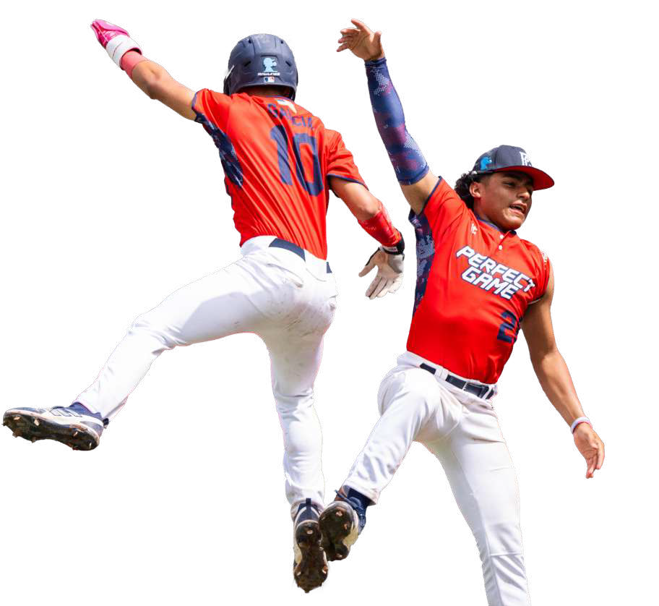

WE BELIEVE
IN CAREER
DEFINING
EXPERIENCES
WE DELIVER THE MOST AUTHENTIC IN CLASS, COMPETITIVE, AND CAREER-DEFINING EXPERIENCES BENEFITTING PLAYERS, FAMILIES, SCOUTS, COLLEGES, AND PROFESSIONAL ORGANIZATIONS ALIKE.

Slide 21
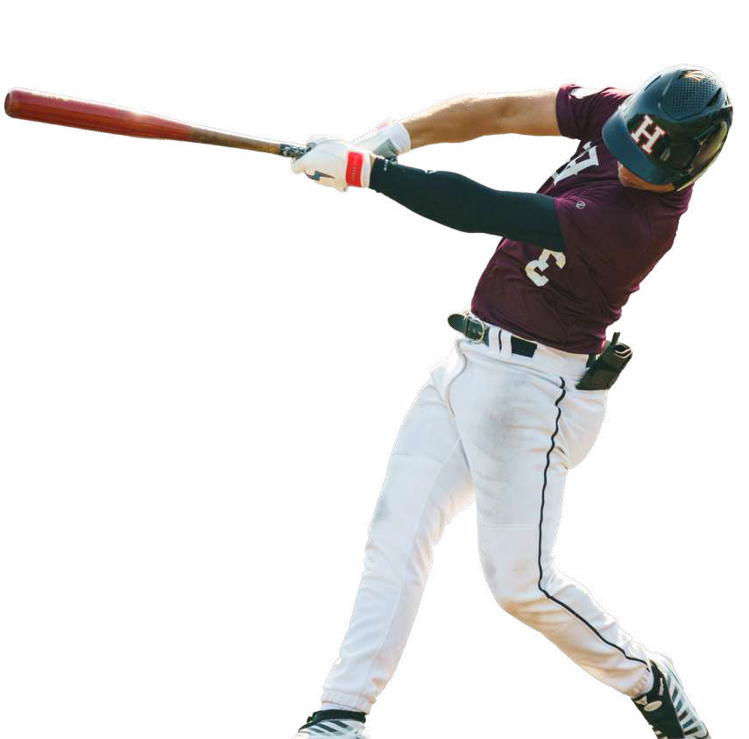
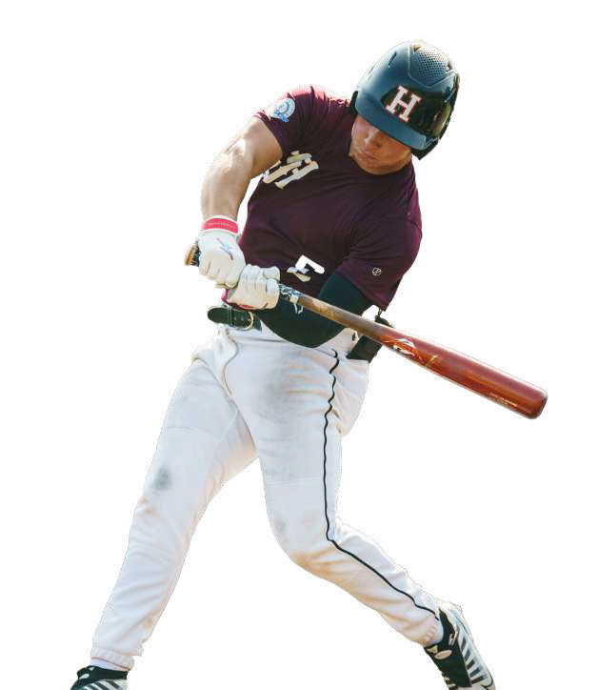

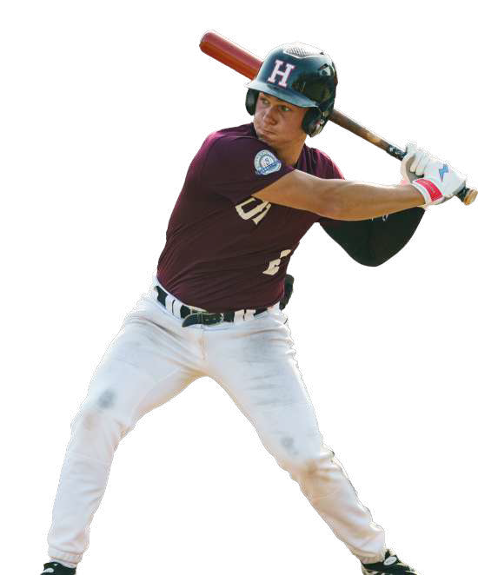
WE BELIEVE
WE BELIEVE IN
DATA DRIVEN PERFORMANCE
WE PROVIDE QUANTITATIVE AND QUALITATIVE PERFORMANCE DATA TO DEVELOP, CHALLENGE, AND EMBOLDEN ATHLETES TO REACH THEIR FULL PLAYING POTENTIAL FOR ANY LEVEL OF PLAY.

Slide 22
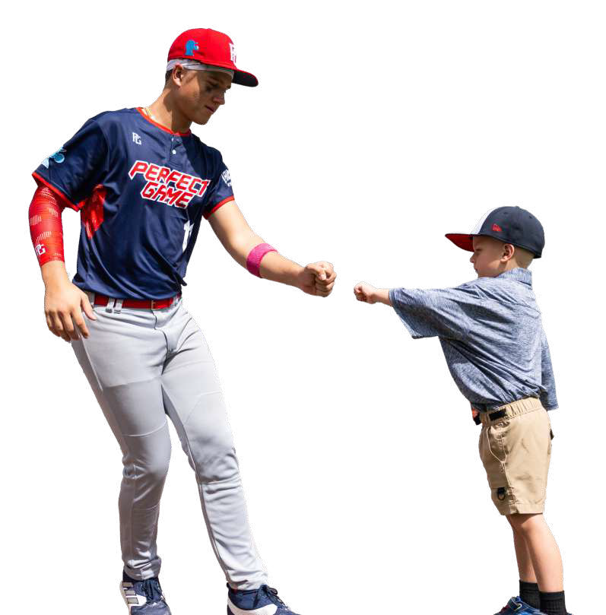

WE BELIEVE
WE BELIEVE IN
ASPIRATIONAL
PLAYING
ENVIRONMENTS
WE INSPIRE ATHLETES AT EVERY SKILL LEVEL TO REALIZE THEIR DREAMS IN THE HIGHEST
PERFORMANCE ENVIRONMENT POSSIBLE - FROM ON THE FIELD TO THE GEAR THEY WEAR.

Slide 23
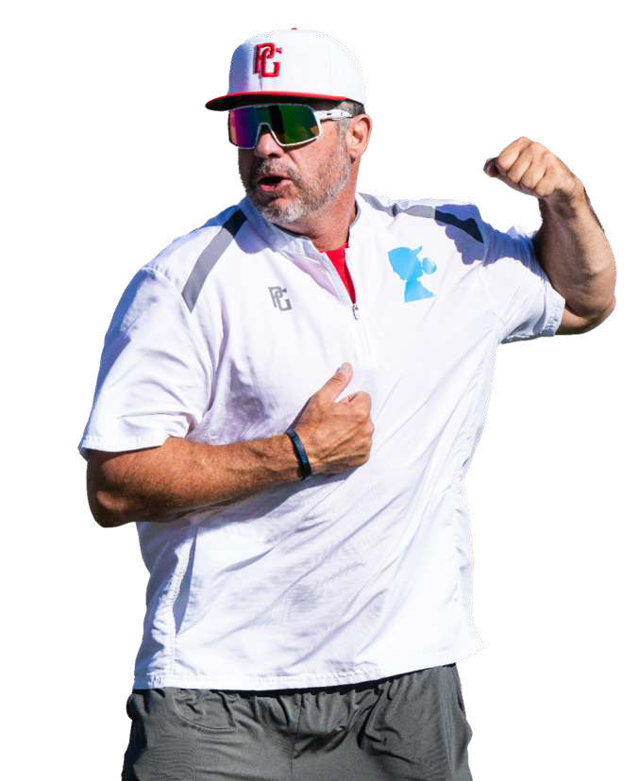

WE BELIEVE
TEAM SPORTS
IS AN EDUCATION PLATFORM
SPORTS TEACHES LIFE LESSONS THAT HELP KIDS WIN BEYOND THE FIELD.
WE HELP UNDERSERVED COMMUNITIES PROVIDE ACCESS TO THE GAME.

Slide 24

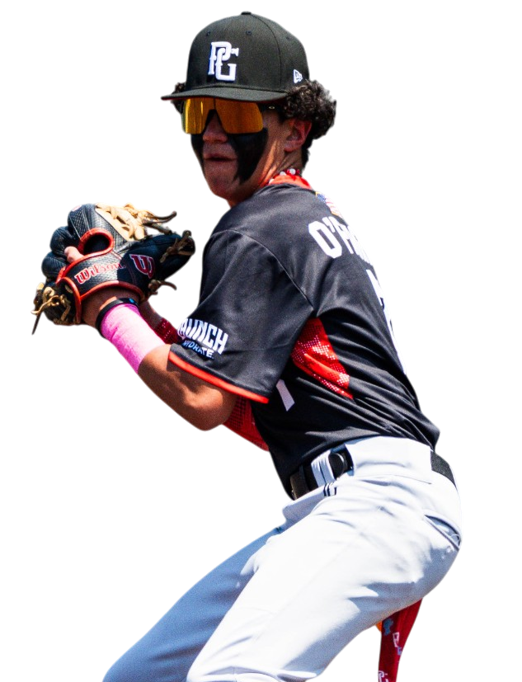

PARTNERSHIPS
WHY PARTNER
WITH US

Slide 25
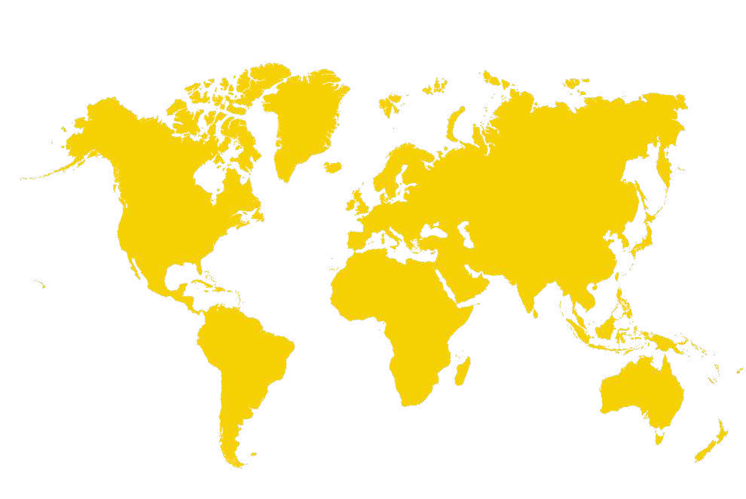

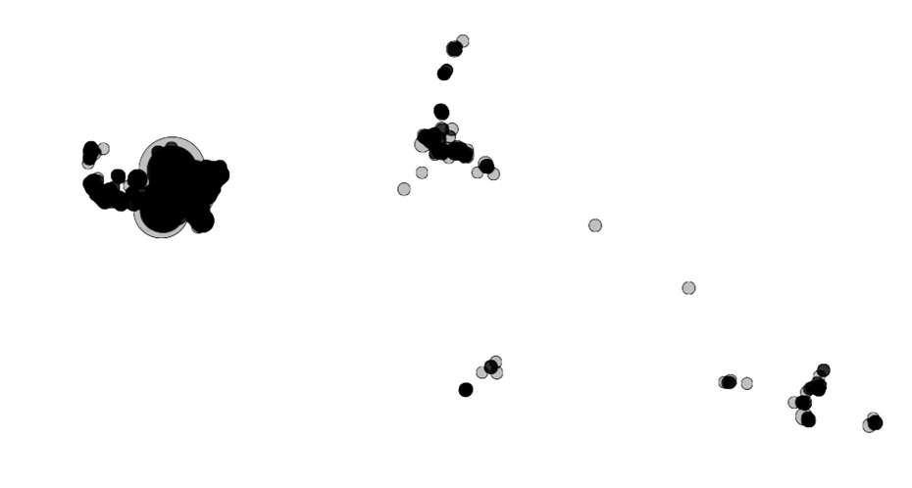
PARTNERSHIPS
PERFECT
GAME IS WORLDWIDE
WE HOLD OVER 11,000 EVENTS ACROSS 44 STATES AND INTERNATIONALLY THROUGHOUT THE ENTIRE YEAR HOSTING
PLAYERS FROM ALL OVER THE WORLD.

Slide 26
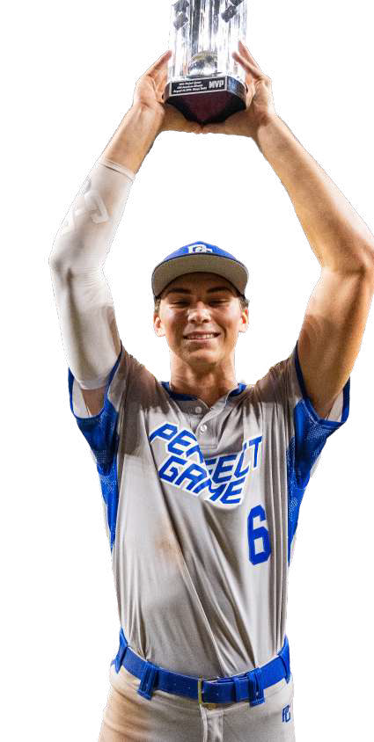


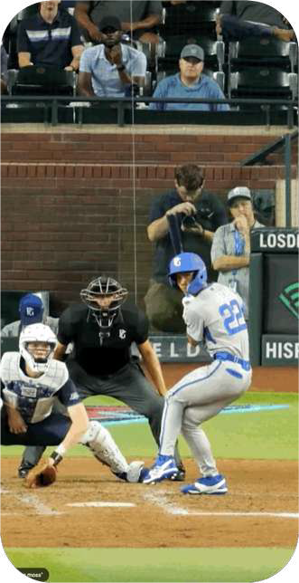
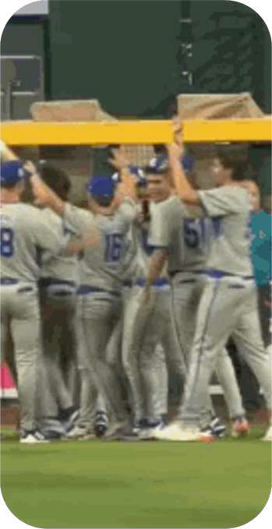


PARTNERSHIPS
PERFECT GAME IS ELITE
WE HOST THE WORLD’S MOST
PRESTIGIOUS EVENTS IN YOUTH AND
HIGH SCHOOL BASEBALL & SOFTBALL.

Slide 27









PERFECT GAME OFFERS SCALE
PARTNERSHIPS
ATTENDANCE
386,590
ATTENDANCE
59,580
ATTENDANCE
160,300
ATTENDANCE
43,375
WE HAVE THE BIGGEST
MOST ATTENDED YOUTH TOURNAMENTS ON THE
PLANET.
ATTENDANCE
43,235
ATTENDANCE
493,500
ATTENDANCE
435,395
ATTENDANCE
105,345

Slide 28
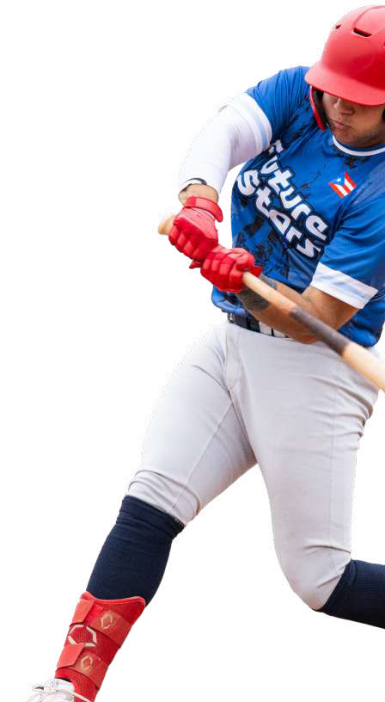

HONING SKILLS
6U+
TOURNAMENTS & LEAGUES
PARTNERSHIPS
8U-14U
ALL-STATE GAMES
EVOLUTION
OF A PG ATHLETE
THE PG JOURNEY STARTS AT 6U WITH TOURNAMENTS, ADVANCING THROUGH ID CAMPS, FESTIVALS, SHOWCASES, AND CULMINATING IN THE ALL-AMERICAN CLASSIC.
9U-12U
ID CAMPS
DEVELOPMENT
11U-14U
SELECT FESTIVALS
EXPOSURE
13U-14U
PROSPECT GATEWAY
15U-18U
SHOWCASES
RECRUITING
13U-18U
NAT’L CHAMPIONSHIPS
13U-18U
NATIONAL SHOWCASES
BRANDING
18U
ALL-AMERICAN CLASSIC
DIAMONDKAST, PG ADVISORS, AND SCOUTS ARE THERE EVERY STEP OF THE WAY.
JUCO/NCAA
EVENTS/COVERAGE
MLB DRAFT
COVERAGE

Slide 29
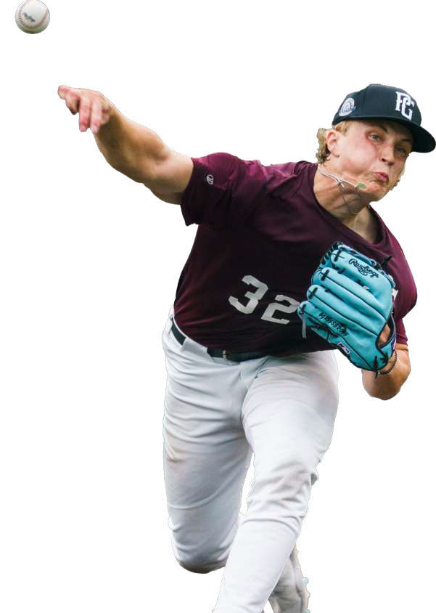


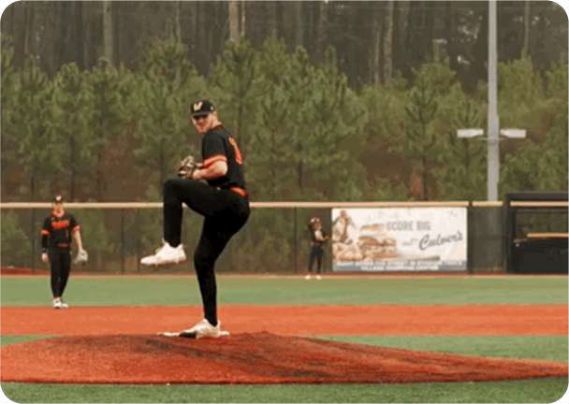
PARTNERSHIPS
WE ARE BUILT ON DATA
WE DELIVER MLB-LEVEL DATA TO OUR
YOUTH MARKET. PERFORMANCE DATA, SCOUT NOTES, RANKINGS, DEVELOPMENT PROGRAMS, AND VIDEO HIGHLIGHTS ALL THROUGH THE LENS OF OUR PLAYER PROFILES.
EVERY SHOWCASE METRIC, PG GAME STAT, EACH AT-BAT OR PITCH THROWN.

Slide 30


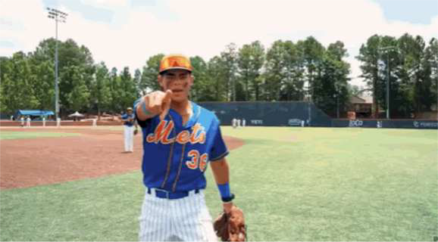


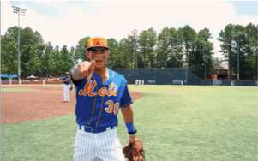













PARTNERSHIPS
PG.TV
SHOWCASES
THE FUTURE
OF BASEBALL
24/7 PROGRAMMING
LIVE & ON-DEMAND COVERAGE
100+ LIVE GAMES
500+ HOURS OF ORIGINAL CONTENT
TOP 5 EVENTS
730,000
VIEWERS
705,000
VIEWERS
627,000
VIEWERS
440,000
VIEWERS
275,000
VIEWERS

Slide 31
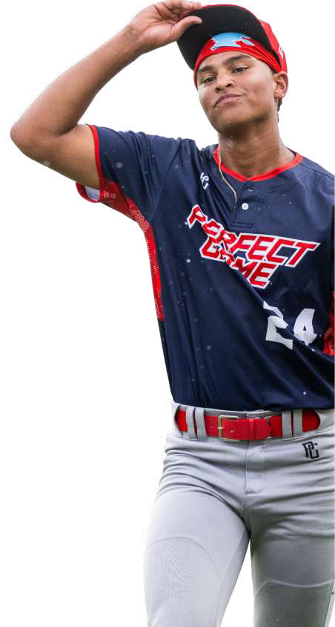





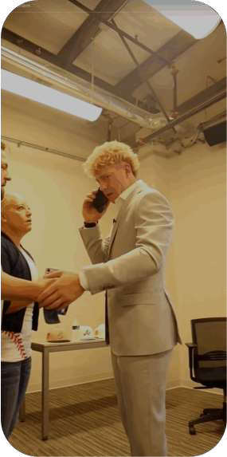
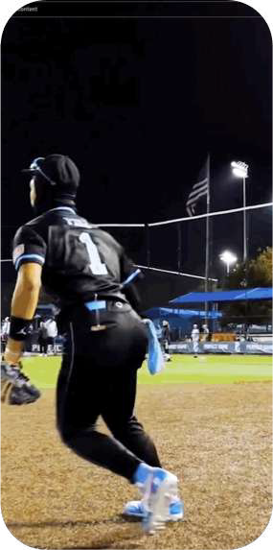

TOMORROW’S STARS = TODAY’S INFLUENCERS
PARTNERSHIPS
WE HAVE UNMATCHED FOOTAGE AND ACCESS OF THE GAME’S NEXT GENERATION OF STARS.
POTTSTOWN
SCOUT TEAM
WE ARE THERE WHEN A 12-YEAR-OLD HITS HIS FIRST HOME RUN, AND WE’RE THERE WITH HIM ON DRAFT DAY AND WE TELL THE STORIES OF ALL THE MOMENTS THAT MATTER IN BETWEEN.
PJ Morlando
31

Slide 32

















INSTAGRAM
TWITTER / X
TIKTOK
YOUTUBE
PARTNERSHIPS
WE’RE
VERY SOCIAL
WE CONNECT YOUTH BASEBALL PERFORMANCE WITH YOUTH BASEBALL CULTURE.
200M
IG VIEWS
410M
X VIEWS
34M
TIKTOK VIEWS
78M
YT VIEWS
1.26M
IG FOLLOWERS
1.27M
X FOLLOWERS
511K
TIKTOK FOLLOWERS
1.26M
YT FOLLOWERS

Slide 33



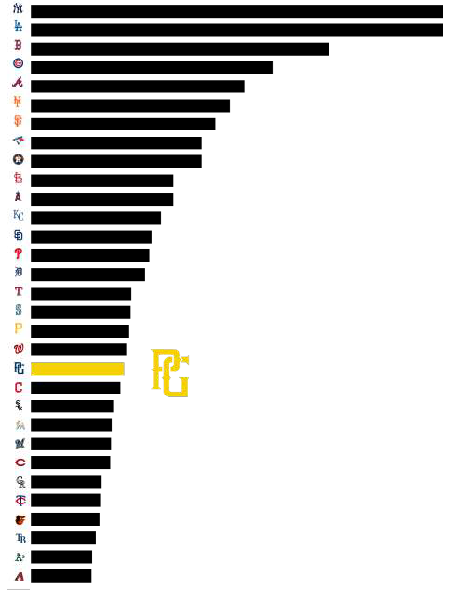
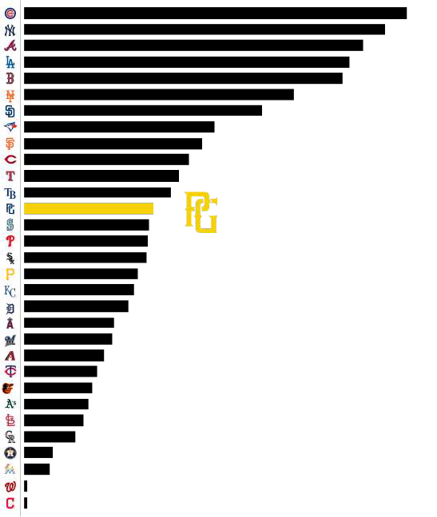
INSTAGRAM
TIKTOK
PARTNERSHIPS
IF WE
WERE
AN MLB TEAM
OUR BRAND PLATFORM COMPETES AMONG THE BIGGEST IN BASEBALL.

Slide 34

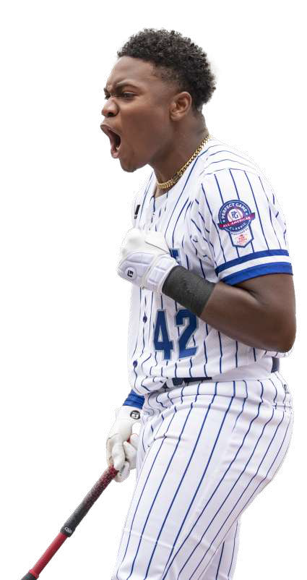




PROFILES GENERATE
PARTNERSHIPS
50M
PAGE VIEWS
PG PLAYER
PROFILES = =
BASEBALL RESUMES
PG PROFILES ARE THE MOST TRUSTED SOURCE OF TRUTH AMONG COLLEGE AND MLB SCOUTS. THEY INCLUDE SCOUTING REPORTS AND PERFORMANCE METRICS FOR EVERY SINGLE GAME, AT-BAT, AND PITCH THROWN.
TERMARR JOHNSON
2021 ALL AMERICAN CLASSIC PLAYER 2018 14U SELECT FESTIVAL PLAYER 2019 14U SELECT FESTIVAL PLAYER 2022 GRAD | SS | ATLANTA, GEORGIA
MLB DRAFT
ROUND 1 - 2022
COMMITMENT
BEST PG GRADE
10
ABOUT PG GRADES
ARIZONA STATE
NATIONAL RANKING GA STATE RANKING
31 21

Slide 35
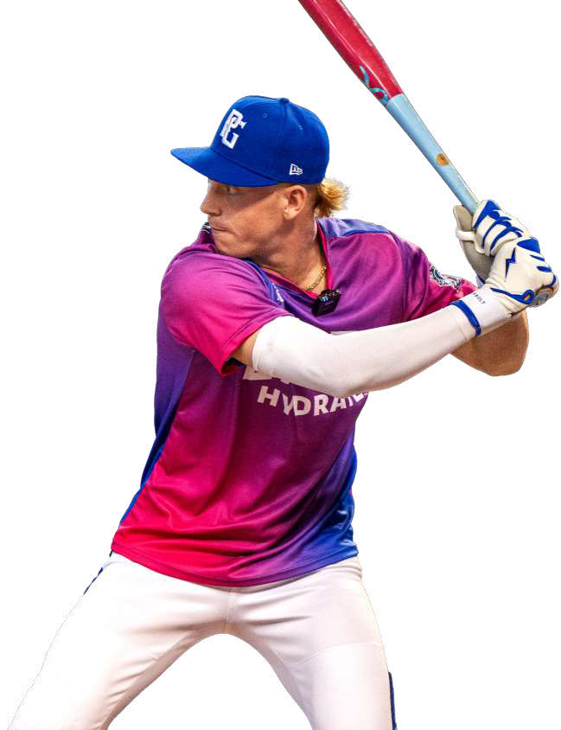


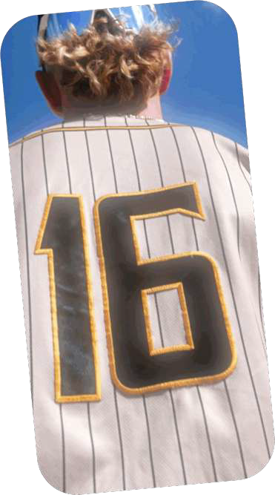



PARTNERSHIPS
POWERED BY
PG PERFORMANCE
OUR PG PERFORMANCE DIGITAL PORTFOLIO PROVIDES PERFORMANCE AND SKILLS DEVELOPMENT METRICS TO PLAYERS, PARENTS, COACHES AND SCOUTS.

Slide 36

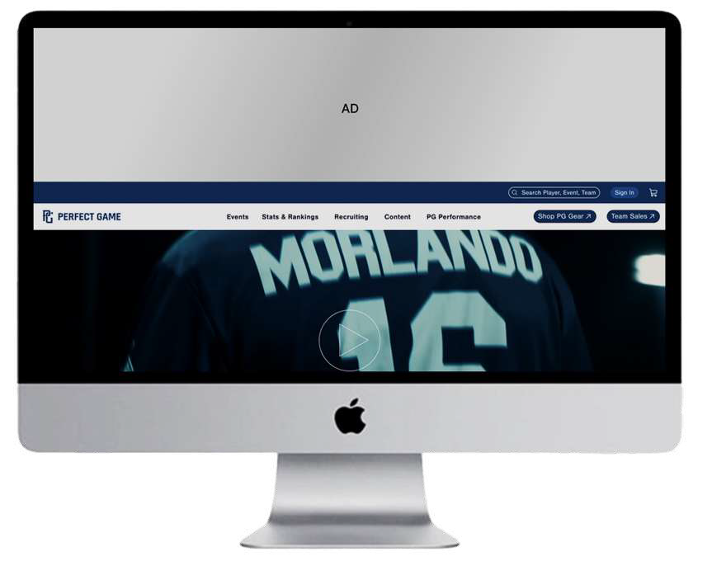

340M WEBSITE VIEWS
PARTNERSHIPS
CLOSE AD X
PERFECTGAME.ORG
IS THE HUB
RUN OF SITE TIER I DISPLAY BANNER PLACEMENTS
GEO-TARGETED
NATIONAL CAMPAIGNS
10, 15 & 30 VIDEO PRE-ROLL ADS BOTH NATIONAL
& GEO-TARGETED BY REGION ON:
PERFECTGAME.ORG
PERFECTGAME.TV

Slide 37




DIRECT RESPONSE WITH A LOYAL AUDIENCE
PARTNERSHIPS
1.67M
DATABASE CONTACTS
Leverage PG’s active database of parents and
players via targeted email campaigns
Geo-targeted
National campaigns
Event specific
Dynamic content

Slide 38



PG BRANDED PRODUCTS
PRODUCTS

Slide 39



PRODUCTS
PG HAS RIZZ
EXISTING PRODUCT BRAND COLLAB
:
DICK’S SPORTING GOODS: PERFORMANCE WEAR, AND OFFICIAL RETAILER OF PG
SOLDIER SPORTS: THE OFFICIAL METAL BAT OF PG
MINE BASEBALL: THE OFFICIAL WOOD BAT OF PG
SPORTS DRINK (LAUNCH HYDRATE)
PG PRODUCT CATEGORIES
APPAREL, HEADWEAR, SUNGLASSES, BASEBALLS, ACCESSORIES & MERCHANDISE

Slide 40


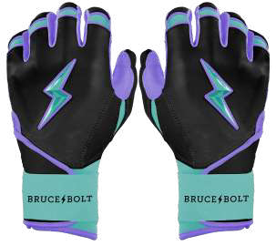
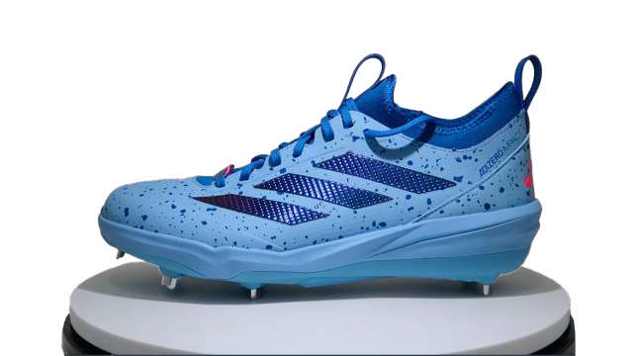
PRODUCTS
THE PG BRAND IS POPPING
WE HAVE EXCITING UPCOMING PRODUCT PARTNERSHIPS WITH:
ADIDAS
BRUCE BOLT

Slide 41



PRODUCTS
WE GOT’EM
ON-SITE,
IN-STORE,
& ON-LINE
IN-STORE AT 250 DICK’S SPORTING GOODS LOCATIONS
ON-SITE AT PG EVENTS AND BRAND ACTIVATIONS
ON-LINE AT SHOP.PG.ORG

Slide 42
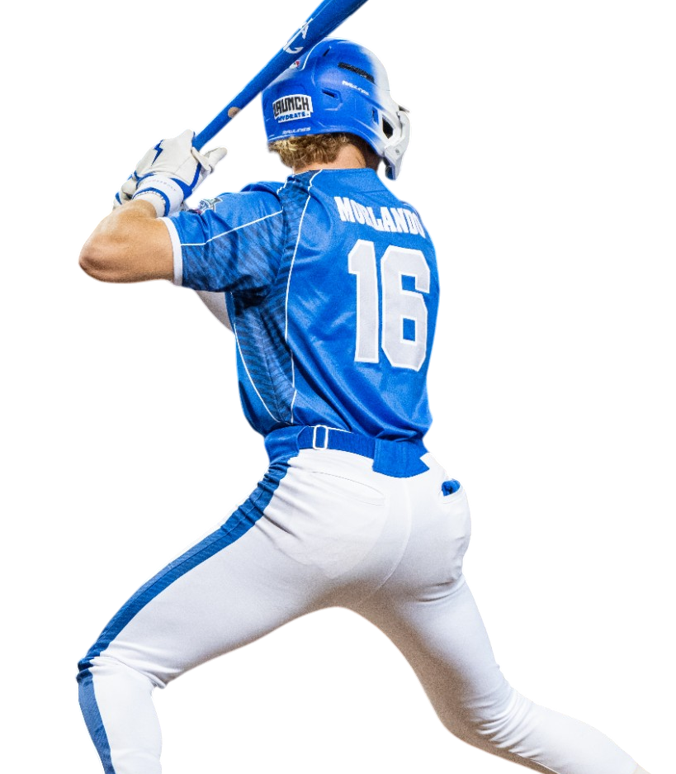

THE
OPPORTUNITY

Slide 43


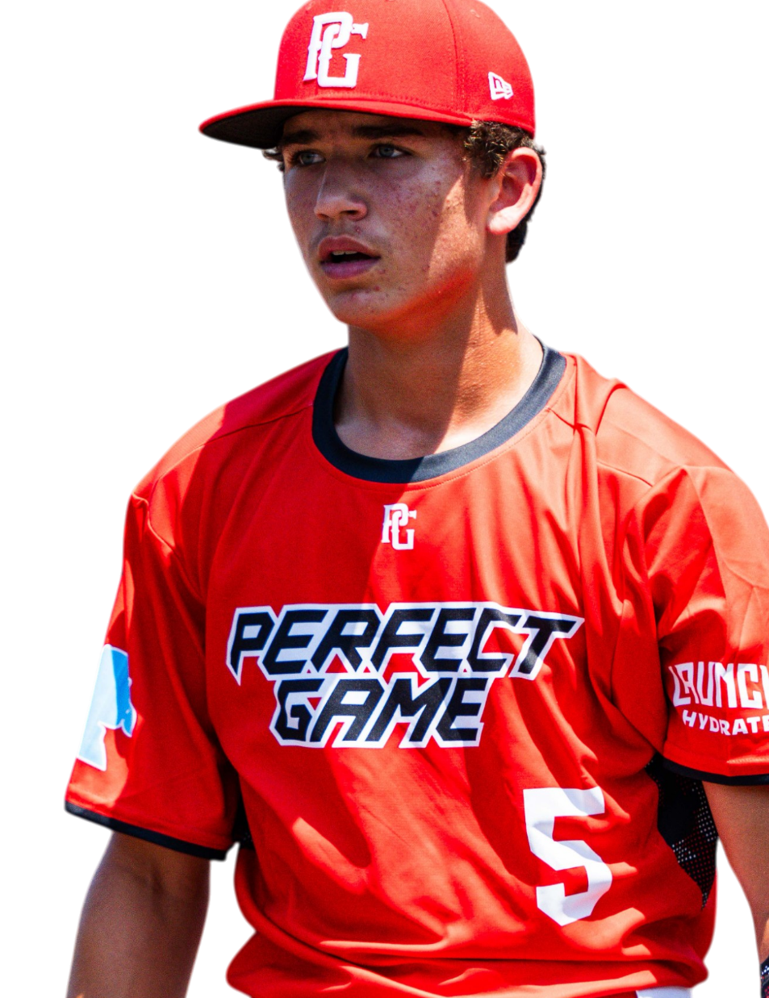
RETAINING THE WORLD’S ELITE BASEBALL & SOFTBALL PLATFORM IN NORTH CAROLINA
A YOUTH BASEBALL & SOFTBALL HUB IN THE CHARLOTTE METROPOLITAN AREA DRIVEN BY THE PG BRAND WITH BACKING OF THE SFC, MLB STARS & PRIVATE EQUITY PARTNERS COULD REVOLUTIONIZE YOUTH BASEBALL & SOFTBALL PLAYERS ACRESS NORTH CAROLINA.
PG SEC IS ON PACE TO HOST 31,000 YOUTH BASEBALL TEAMS THROUGH 2025 & 4000 SOFTBALL TEAMS THROUGHT THE STATES OF ALABAMA, GEORGIA, NORTH CAROLINA, SOUTH CAROLINA, TENNESSEE & VIRGINIA.
CHARLOTTE HUB
CHARLOTTE HAS BECOME A DESIRED BASEBALL TRAVEL LOCATION
AA / AAA / MAJORS
LOCAL, REGIONAL & NATIONAL TALENT ON THE PREMIER PG PLATFORM
ADVANCED DATA
INDUSTRY LEADING SCOUTINGDATA AND ANALYTICS
PG BRAND & ASSETS
PG MEDIA LEADING BEST-IN-CLASS CONTENT PAIRED WITH IN-DEMAND MERCHANDISE
43

Slide 44
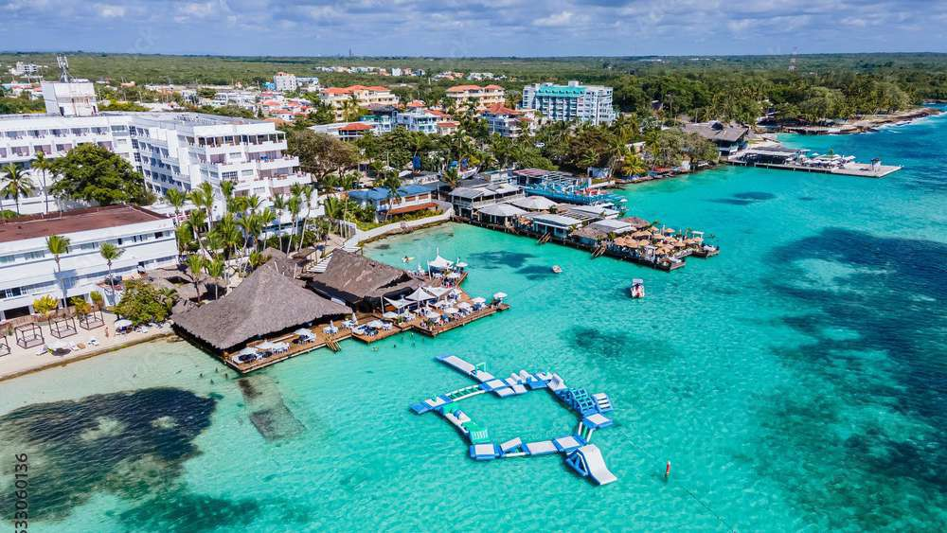


PG ECONOMIC IMPACT
PG REPRESENTS THE “TIP OF THE SPEAR” WHEN IT COMES TO SPORTS TOURISM.
DRIVING SIGNIFICANT VISITATION, ROOM NIGHTS AND DIRECT SPENDING THROUGH ITS TOURNAMENTS AND EVENTS.
STATESVILLE, NORTH CAROLINA
OVERVIEW | 2025 ₄₆

Slide 45











REGIONAL & NATIONAL TOURNAMENTS
SOME OF THE VERY BEST COUNTRIES, TEAMS AND PLAYERS IN THE GAME TODAY
STATESVILLE, SOUTH CAROLINA
OVERVIEW | 2025
47

Slide 46





POWERFUL MEDIA REACH
PG WILL AMPLIFY AND EXTEND THE REACH OF MARKETING THE DESTINATION EFFORTS FOR THE CITY OF STATESVILLE.
THROUGH IT’S POWERFUL MEDIA PLATFORMS AND BEST IN-CLASS CONTENT.
STATESVILLE, SOUTH CAROLINA
OVERVIEW | 2025
49

Slide 47



NEXT STEPS
OUR PLAN WILL LEVERAGE THE PG BRAND, THE PREMIER BRAND EQUITY AND RELATIONSHIPS CARRIED
LOCALLY BY OUR TEAMS TO MAXIMIZE PG EVENTS & TOURNAMENTS
THE KEY NEXT STEP IS TO ALIGN ON THE PREFERRED INVESTMENT STRATEGY
BETWEEN PERFECT GAME & THE CITY OF STATESVILLE
Further the relationship between Perfect Game and The Iredell Park and
Recreation to create a comprehensive plan. We would love to develop a
three-year strategic plan to identify its economic impact and provide a
social and financial valuation. This framework will provide a clear roadmap
for future development, growth, and financial sustainability.
Identify investment strategy between PG and Iredell Park & Recreation.
Create execution plan and initiate activities.
Set up regular cadence between PG and Iredell Park and Recreation until completion.
52

Slide 48




THANK YOU
PERFECT GAME
OVERVIEW | 2025

Slide 49



CASE STUDIES + PG REFERENCES

Slide 50



RACHEL ROGERS
SPORTS SALES & SERVICES MANAGER
COBB TRAVEL & TOURISM
COBB SPORTS ALLIANCE
ONE GALLERIA PARKWAY
ATLANTA, GA 30339
TOLL FREE 800-451-3480
LOCAL 678-303-2630
PG PERFORMANCE TESTIMONIAL:
COBB COUNTY, GEORGIA
OVERVIEW - In Georgia’s Cobb County the annual economic impact that perfect game brings with it is pegged at $139mm by Cobb County officials. The surrounding counties at LakePoint benefitted from Perfect Game tournaments with the construction of hotels, fast food restaurants and other family themed properties with PG clearly the foundation of the economic stimulus. Total economic impact in the Atlanta area is estimated at over $300mm.
“Perfect game has become a part of the fabric of our community over the years. Every member of the organization from the top down is professional and timely with communication and deliverables, more often than not exceeding expectations in terms of tournament numbers and growth year over year. It is a pleasure working with perfect game.”
– Rachel Rogers, Cobb Travel & Tourism
ANNUAL ECONOMIC IMPACT:
$139 MILLION
TOTAL ECONOMIC IMPACT (ATLANTA):
$300 MILLION

Slide 51






MOBILYTICS INSIGHTS:
MOBILYTICS INSIGHTS:
PROVIDES INSIGHTS INTO THE HOME LOCATIONS BY DENSITY FOR THE EAST COBB BASEBALL COMPLEX
VISITOR TRADE AREA FOR THE EAST COBB
BASEBALL COMPLEX IN GEORGIA.
ONLY 32% OF VISITORS ORIGINATED FROM WITHIN 20 MILES OF THE PG EAST COBB BASEBALL COMPLEX.
TOP OUT-OF-TOWN MARKETS INCLUDE - NASHVILLE, BIRMINGHAM, CHATTANOOGA, COLUMBUS (GA), RALEIGH- DURHAM, TAMPA, MOBILE, NEW YORK, AND MIAMI.
TOP 6 CUSTOMER HOUSEHOLD SEGMENTS BY % OF VISITORS ARE IN WEALTHIEST LIFESTYLE SEGMENTS.
THE NEXT LEVEL STARTS HERE.

Slide 52

JEFF MIELKE EXECUTIVE DIRECTOR
LEE COUNTY SPORTS DEVELOPMENT
FORT MYERS, FL 33901
239-533-LCSD (5273)
239-707-3951 MOBILE
PG PERFORMANCE TESTIMONIAL:
FORT MYERS, FLORIDA
OVERVIEW
USING A MODEL SUPPORTED BY THE FLORIDA SPORTS FOUNDATION, LEE COUNTY SPORTS CALCULATED THAT PERFECT GAME HAS DRIVEN AN ESTIMATED ANNUAL ECONOMIC IMPACT OF $53 MILLION DOLLARS FOR LEE COUNTY, FLORIDA THROUGH 72 DIFFERENT EVENTS.
OVER THE PREVIOUS FIVE YEARS, PERFECT GAME HAS HELD AN AVERAGE OF 41 EVENTS PER YEAR IN LEE COUNTY. THIS ACTIVITY RESULTED IN AN AVERAGE OF $29.6 MILLION IN DIRECT SPENDING PER YEAR WITH AN ANNUAL AVERAGE OF 67,846 HOTEL ROOM NIGHTS FILLED, ACCORDING TO COUNTY RECORDS.
– JEFF MIELKE, DIRECTOR OF COUNTY SPORTS DEVELOPMENT
ANNUAL ECONOMIC IMPACT:
$53 MILLION

Slide 53



MOBILYTICS INSIGHTS:
PROVIDES INSIGHTS INTO THE HOME LOCATIONS BY DENSITY FOR THE FENWAY SOUTH PARK BASEBALL COMPLEX
VISITOR TRADE AREA FOR THE FORT MYERS
BASEBALL COMPLEX IN FLORIDA.
ONLY 26 % OF VISITORS ORIGINATED FROM WITHIN 20 MILES OF THE FENWAY SOUTH PARK BASEBALL COMPLEX
TOP OUT-OF-TOWN MARKETS INCLUDE - BOSTON, TAMPA, MIAMI, NEW YORK, ATLANTA, RHODE ISLAND AND MINNEAPOLIS-ST PAUL.
TOP 6 CUSTOMER HOUSEHOLD SEGMENTS BY % OF VISITORS ARE IN WEALTHIEST LIFESTYLE SEGMENTS.
THE NEXT LEVEL STARTS HERE.

Slide 54

PG PERFORMANCE TESTIMONIAL:
GEORGE LINLEY
EXECUTIVE DIRECTOR
PALM BEACH COUNTY/SPORTS COMMISSION
2195 SOUTHERN BLVD., SUITE 550 WEST PALM BEACH, FL 33406
DIRECT LINE: 561.233.3123
PALM BEACH COUNTY,
FLORIDA
OVERVIEW:
OVER $35 MILLION OF ECONOMIC IMPACT HAS BEEN CREATED SINCE THE PERFECT GAME WWBA WORLD CHAMPIONSHIP HAS CALLED PALM BEACH COUNTY HOME; A NUMBER THAT IS EXPECTED TO GROW BASED ON THE ADDITION OF A SECOND WORLD CHAMPIONSHIP EVENT.
MORE THAN 1,000 GOLF CARTS ARE MADE AVAILABLE FOR MLB SCOUTS AND COLLEGE COACHES WHO TRAVEL IN FOR THE WWBA EVENT.
“THE PALM BEACH COUNTY SPORTS COMMISSION HAS ENJOYED AN INCREDIBLE PARTNERSHIP WITH PERFECT GAME FOR NEARLY TWO DECADES. PERFECT GAME IS A WORLD-CLASS ORGANIZATION THAT OFFERS HIGH QUALITY TOURNAMENTS AND SHOWCASES, WHICH REPRESENT THE BEST OF TRAVEL SPORTS. PERFECT GAME DEMONSTRATES THE HIGHEST LEVEL OF EXCELLENCE IN CUSTOMER SERVICE AND PROVIDING A MEMORABLE EXPERIENCE FOR THEIR PARTICIPANTS. PERFECT GAME IS THE GOLD STANDARD IN AMATEUR SPORTS. ”
– GEORGE LINLEY, EXECUTIVE DIRECTOR PALM BEACH COUNTY SPORTS COMMISSION
TOTAL ECONOMIC IMPACT:
$35 MILLION

Slide 55

MOBILYTICS INSIGHTS:
PROVIDES INSIGHTS INTO THE HOME LOCATIONS BY DENSITY FOR THE WEST PALM BASEBALL COMPLEX
VISITOR TRADE AREA FOR THE WEST PALM
BASEBALL COMPLEX IN FLORIDA.
ONLY 30% OF VISITORS ORIGINATED FROM WITHIN 20 MILES OF THE PG WEST PALM BASEBALL COMPLEX
TOP OUT-OF-TOWN MARKETS INCLUDE - MIAMI, ST. LOUIS, TAMPA, WASHINGTON DC, PHILADELPHIA AND HOUSTON.
TOP 6 CUSTOMER HOUSEHOLD SEGMENTS BY OF VISITORS ARE IN WEALTHIEST LIFESTYLE SEGMENT.
THE NEXT LEVEL STARTS HERE.

Slide 56

CASE STUDIES+
SUPPORT DATA

Slide 57


CASE STUDY
CASE STUDY - CEDAR PARK, TEXAS

Slide 58







CITY OF CEDAR PARK, TEXAS
VISITATION & ECONOMIC IMPACT FORECASTS
(MARKET RESEARCH BY SPORTS FACILITIES ADVISORY)
8,810 TEAMS WILL VISIT THE MARKET ANNUALLY
313,887 HOTEL ROOM NIGHTS ANNUALLY
982,962 NON-LOCAL VISITORS TO MARKET ANNUALLY
$132.6 MILLION IN DIRECT SPENDING ANNUALLY
CASE STUDY - CEDAR PARK, TEXAS

Slide 59

THE CITY OF CEDAR PARK PARTNERED WITH PERFECT GAME ON A NATIONAL YOUTH BASEBALL DESTINATION
THE GOALS WERE TO BUILD A 16-FIELD BASEBALL COMPLEX THAT WILL ANCHOR ANCILLARY RETAIL DEVELOPMENT
CASE STUDY - CEDAR PARK, TEXAS

Slide 60

THE FACILITY
HAS BEEN MASTER PLANNED
TO INCLUDE RETAIL, HOTEL AND
RESTAURANTS IMMEDIATELY ADJACENT TO THE
COMPLEX
THERE ARE 11 LOTS REPRESENTING
20 ACRES OF ANCILLARY DEVELOPMENT
CASE STUDY - CEDAR PARK, TEXAS

Slide 61


PERFECT GAME ROOM NIGHTS ANALYSIS
Event Type | Year 1 | Total Number of Teams Year 2 Year 3 Year 4 |  |  | Year 5 |  | Rooms per Team/Night | Scout Rooms/Night | Nights per Event | Percent Non-Local | Year 1 | Year 2 | Room Nights Year 3 |  |  | Year 4 | Year 5
Spring Tournaments and Events
Texas Spring Select (6 ages) | 112 | 118 | 123 | 130 |  | 136 | 10.0 | - | 2.0 | 60% | 1,344 | 1,411 |  | 1,482 | 1,556 |  | 1,634
Texas Spring Elite (6 ages) | 112 | 118 | 123 | 130 |  | 136 | 10.0 | - | 2.0 | 60% | 1,344 | 1,411 |  | 1,482 | 1,556 |  | 1,634
St Pattys Day Classic (6 ages) | 112 | 118 | 123 | 130 |  | 136 | 10.0 | - | 2.0 | 60% | 1,344 | 1,411 |  | 1,482 | 1,556 |  | 1,634
South Spring Select (6 ages) | 112 | 118 | 123 | 130 |  | 136 | 10.0 | - | 2.0 | 60% | 1,344 | 1,411 |  | 1,482 | 1,556 |  | 1,634
April Fools Classic (6 ages) | 112 | 118 | 123 | 130 |  | 136 | 10.0 | - | 2.0 | 60% | 1,344 | 1,411 |  | 1,482 | 1,556 |  | 1,634
South Spring Elite (6 ages) | 112 | 118 | 123 | 130 |  | 136 | 10.0 | - | 2.0 | 60% | 1,344 | 1,411 |  | 1,482 | 1,556 |  | 1,634
Easter Classic (6 ages) | 112 | 118 | 123 | 130 |  | 136 | 10.0 | - | 2.0 | 60% | 1,344 | 1,411 |  | 1,482 | 1,556 |  | 1,634
Texas Spring World Series (6 ages) | 112 | 118 | 123 | 130 |  | 136 | 10.0 | - | 2.0 | 60% | 1,344 | 1,411 |  | 1,482 | 1,556 |  | 1,634
South Spring World Series (6 ages) | 112 | 118 | 123 | 130 |  | 136 | 10.0 | - | 2.0 | 60% | 1,344 | 1,411 |  | 1,482 | 1,556 |  | 1,634
Mothers Day (6 ages) | 112 | 118 | 123 | 130 |  | 136 | 10.0 | - | 2.0 | 60% | 1,344 | 1,411 |  | 1,482 | 1,556 |  | 1,634
Texas Shootout (6 ages) | 112 | 118 | 123 | 130 |  | 136 | 10.0 | - | 2.0 | 60% | 1,344 | 1,411 |  | 1,482 | 1,556 |  | 1,634
South Shootout (6 ages) | 112 | 118 | 123 | 130 |  | 136 | 10.0 | - | 2.0 | 60% | 1,344 | 1,411 |  | 1,482 | 1,556 |  | 1,634
Memorial Day Classic (10 ages) | 240 | 252 | 265 | 278 |  | 292 | 12.0 | 40.0 | 3.0 | 80% | 7,032 | 7,378 |  | 7,740 | 8,122 |  | 8,522
Summer Tournaments and Events
Texas Select Championships (10 ages) | 112 | 118 | 123 | 130 |  | 136 | 12.0 | 10.0 | 3.0 | 60% | 2,449 | 2,570 |  | 2,697 | 2,831 |  | 2,971
Texas Elite Championships (10 ages) | 112 | 118 | 123 | 130 |  | 136 | 12.0 | 10.0 | 4.0 | 60% | 3,266 | 3,427 |  | 3,596 | 3,774 |  | 3,961
End of School Classic (10 ages) | 112 | 118 | 123 | 130 |  | 136 | 12.0 | 10.0 | 4.0 | 60% | 3,266 | 3,427 |  | 3,596 | 3,774 |  | 3,961
WWBA National Championship 14u | 240 | 252 | 265 | 278 |  | 292 | 12.0 | 80.0 | 6.0 | 80% | 14,304 | 14,995 |  | 15,721 | 16,483 |  | 17,283
Freedom Classic (10 ages) | 240 | 252 | 265 | 278 |  | 292 | 12.0 | - | 3.0 | 60% | 5,184 | 5,443 |  | 5,715 | 6,001 |  | 6,301
WWBA National Championship 18u | 160 | 168 | 176 | 185 |  | 194 | 16.0 | 40.0 | 5.0 | 80% | 10,440 | 10,952 |  | 11,490 | 12,054 |  | 12,647
WWBA National Championship 17u | 400 | 420 | 441 | 463 |  | 486 | 16.0 | 500.0 | 6.0 | 80% | 33,720 | 35,256 |  | 36,869 | 38,562 |  | 40,340
WWBA National Championship 16u | 400 | 420 | 441 | 463 |  | 486 | 16.0 | 500.0 | 6.0 | 80% | 33,720 | 35,256 |  | 36,869 | 38,562 |  | 40,340
WWBA National Championship 15u | 360 | 378 | 397 | 417 |  | 438 | 15.0 | 200.0 | 6.0 | 80% | 27,120 | 28,416 |  | 29,777 | 31,206 |  | 32,706
PG World Series (5 ages) | 200 | 210 | 221 | 232 |  | 243 | 16.0 | 200.0 | 4.0 | 80% | 11,040 | 11,552 |  | 12,090 | 12,654 |  | 13,247
Texas World Series (5 ages) | 120 | 126 | 132 | 139 |  | 146 | 12.0 | 50.0 | 4.0 | 80% | 4,808 | 5,038 |  | 5,280 | 5,534 |  | 5,801
Texas World Series (5 ages) | 120 | 126 | 132 | 139 |  | 146 | 12.0 | 50.0 | 4.0 | 80% | 4,808 | 5,038 |  | 5,280 | 5,534 |  | 5,801
Back to School Brawl (10 ages) | 112 | 118 | 123 | 130 |  | 136 | 12.0 | 10.0 | 2.0 | 60% | 1,633 | 1,713 |  | 1,798 | 1,887 |  | 1,980
End of Summer Classic (10 ages) | 112 | 118 | 123 | 130 |  | 136 | 12.0 | 10.0 | 2.0 | 60% | 1,633 | 1,713 |  | 1,798 | 1,887 |  | 1,980
Fall Tournaments and Events
Labor Day Classic (10 ages) | 240 | 252 | 265 | 278 |  | 292 | 12.0 | 50.0 | 3.0 | 80% | 7,062 | 7,408 |  | 7,770 | 8,152 |  | 8,552
WWBA South Qualifier (10 ages) | 112 | 118 | 123 | 130 |  | 136 | 12.0 | 50.0 | 3.0 | 80% | 3,376 | 3,537 |  | 3,706 | 3,884 |  | 4,071
WWBA Freshman World Championship | 128 | 134 | 141 | 148 |  | 156 | 12.0 | 200.0 | 4.0 | 80% | 5,715 | 5,961 |  | 6,219 | 6,490 |  | 6,774
WWBA Sophomore World Championship | 128 | 134 | 141 | 148 |  | 156 | 15.0 | 200.0 | 4.0 | 80% | 6,944 | 7,251 |  | 7,574 | 7,912 |  | 8,268
WWBA Underclass World Championship | 240 | 252 | 265 | 278 |  | 292 | 16.0 | 500.0 | 4.0 | 80% | 14,288 | 14,902 |  | 15,548 | 16,225 |  | 16,936
WWBA World Championship | 112 | 118 | 123 | 130 |  | 136 | 20.0 | 1,000.0 | 4.0 | 80% | 11,168 | 11,526 |  | 11,903 | 12,298 |  | 12,713
WWBA 14u World Championship | 112 | 118 | 123 | 130 |  | 136 | 12.0 | 100.0 | 4.0 | 80% | 4,701 | 4,916 |  | 5,142 | 5,379 |  | 5,628
WWBA 13u World Championship | 112 | 118 | 123 | 130 |  | 136 | 12.0 | 20.0 | 3.0 | 80% | 3,286 | 3,447 |  | 3,616 | 3,794 |  | 3,981
Halloween Bash (10 ages) | 112 | 118 | 123 | 130 |  | 136 | 12.0 | - | 2.0 | 60% | 1,613 | 1,693 |  | 1,778 | 1,867 |  | 1,960
Fall World Series (6 ages) | 112 | 118 | 123 | 130 |  | 136 | 10.0 | - | 2.0 | 80% | 1,792 | 1,882 |  | 1,976 | 2,074 |  | 2,178
Veterans Day Classic (10 ages) | 112 | 118 | 123 | 130 |  | 136 | 10.0 | - | 2.0 | 60% | 1,344 | 1,411 |  | 1,482 | 1,556 |  | 1,634
South Fall Elite (10 ages) | 112 | 118 | 123 | 130 |  | 136 | 10.0 | - | 2.0 | 60% | 1,344 | 1,411 |  | 1,482 | 1,556 |  | 1,634
Turkey Day Classic (10 ages) | 112 | 118 | 123 | 130 |  | 136 | 10.0 | - | 2.0 | 60% | 1,344 | 1,411 |  | 1,482 | 1,556 |  | 1,634
Winter Tournaments and Events
South Fall Select (10 ages) | 112 | 118 | 123 | 130 |  | 136 | 10.0 | - | 2.0 | 60% | 1,344 | 1,411 |  | 1,482 | 1,556 |  | 1,634
Texas Snowfall Classic (10 ages) | 112 | 118 | 123 | 130 |  | 136 | 10.0 | - | 2.0 | 60% | 1,344 | 1,411 |  | 1,482 | 1,556 |  | 1,634
Christmas Bash (10 ages) | 112 | 118 | 123 | 130 |  | 136 | 10.0 | - | 2.0 | 60% | 1,344 | 1,411 |  | 1,482 | 1,556 |  | 1,634
Season Opener (10 ages) | 112 | 118 | 123 | 130 |  | 136 | 12.0 | - | 2.0 | 60% | 1,613 | 1,693 |  | 1,778 | 1,867 |  | 1,960
MLK Championships (10 ages) | 112 | 118 | 123 | 130 |  | 136 | 12.0 | 20.0 | 3.0 | 60% | 2,479 | 2,600 |  | 2,727 | 2,861 |  | 3,001
Texas Winter Select (6 ages) | 112 | 118 | 123 | 130 |  | 136 | 10.0 | - | 2.0 | 60% | 1,344 | 1,411 |  | 1,482 | 1,556 |  | 1,634
Texas Winter Elite (6 ages) | 112 | 118 | 123 | 130 |  | 136 | 10.0 | - | 2.0 | 60% | 1,344 | 1,411 |  | 1,482 | 1,556 |  | 1,634
South Winter Select (6 ages) | 112 | 118 | 123 | 130 |  | 136 | 10.0 | - | 2.0 | 60% | 1,344 | 1,411 |  | 1,482 | 1,556 |  | 1,634
Cupid Classic (6 ages) | 112 | 118 | 123 | 130 |  | 136 | 10.0 | - | 2.0 | 60% | 1,344 | 1,411 |  | 1,482 | 1,556 |  | 1,634
Presidents Day Challenge (6 ages) | 112 | 118 | 123 | 130 |  | 136 | 10.0 | - | 3.0 | 60% | 2,016 | 2,117 |  | 2,223 | 2,334 |  | 2,450
South Winter Elite (6 ages) | 112 | 118 | 123 | 130 |  | 136 | 10.0 | - | 2.0 | 60% | 1,344 | 1,411 |  | 1,482 | 1,556 |  | 1,634
 |  | Total Number of Room Nights |  |  |  |  |  |  |  |  | 261,386 | 273,567 |  | 286,357 | 299,786 |  | 313,887
PERFECT GAME ROOM NIGHTS NATIONAL TOURNAMENT AND EVENTS COMPLEX - CEDAR PARK, TEXAS
 | SIZE 313,887 ROOM NIGHTS LOCATION CEDAR PARK ,TEXAS | PERFECT GAME’S ROOM NIGHT ANALYSIS IS AN ESTIMATE OF THE OVERNIGHT STAYS THAT WILL BE GENERATED BASED ON THE NON-LOCAL VISITATION FORECASTED FOR EACH EVENT.
 | PG COMPARABLES COBB COUNTY, GA LEE COUNTY, FT. MYERS, FL PALM BEACH COUNTY, FL HOOVER MET COMPLEX, AL | ROOM NIGHTS ARE ESTIMATED FOR EACH TEAM (WHICH INCLUDES PLAYERS, COACHES AND PARENTS AS WELL AS THE ANTICIPATED ATTENDANCE OF MLB SCOUTS AND/OR COLLEGE COACHES FOR EACH EVENT. AT MATURITY IS ANTICIPATED THAT PERFECT GAME WILL GENERATE MORE THAN 313,000 ROOM NIGHTS FOR CEDAR PARK AND THE SURROUNDING MARKETPLACE ON AN ANNUAL BASIS, WITH MORE THAN 261,000 ANTICIPATED IN YEAR ONE.
CASE STUDY - CEDAR PARK, TEXAS
TH I S P R O J E C T H A S B E E N F U L L Y V E TTE D A N D R E S E A R C H E D B Y S F A

Slide 62

PERFECT GAME NON-LOCAL VISITATION
_{Event Type} Number of Unique Visitors Event Days per Percent Non-Local Visitor Days Year 1 Year 2 Year 3 Year 4 Year 5 Length Non-Local Non-Local Year 1 Year 2 Year 3 Year 4 Year 5
Spring Tournaments and Events
Texas Spring Select (6 ages) | 3,864 | 4,057 | 4,260 | 4,473 | 4,697 | 3.0 | 2.0 | 60% | 4,637 | 4,869 | 5,112 | 5,368 | 5,636
Texas Spring Elite (6 ages) | 3,864 | 4,057 | 4,260 | 4,473 | 4,697 | 3.0 | 2.0 | 60% | 4,637 | 4,869 | 5,112 | 5,368 | 5,636
St Pattys Day Classic (6 ages) | 3,864 | 4,057 | 4,260 | 4,473 | 4,697 | 3.0 | 2.0 | 60% | 4,637 | 4,869 | 5,112 | 5,368 | 5,636
South Spring Select (6 ages) | 3,864 | 4,057 | 4,260 | 4,473 | 4,697 | 3.0 | 2.0 | 60% | 4,637 | 4,869 | 5,112 | 5,368 | 5,636
April Fools Classic (6 ages) | 3,864 | 4,057 | 4,260 | 4,473 | 4,697 | 3.0 | 2.0 | 60% | 4,637 | 4,869 | 5,112 | 5,368 | 5,636
South Spring Elite (6 ages) | 3,864 | 4,057 | 4,260 | 4,473 | 4,697 | 3.0 | 2.0 | 60% | 4,637 | 4,869 | 5,112 | 5,368 | 5,636
Easter Classic (6 ages) | 3,864 | 4,057 | 4,260 | 4,473 | 4,697 | 2.0 | 2.0 | 60% | 4,637 | 4,869 | 5,112 | 5,368 | 5,636
Texas Spring World Series (6 ages) | 3,864 | 4,057 | 4,260 | 4,473 | 4,697 | 3.0 | 2.0 | 60% | 4,637 | 4,869 | 5,112 | 5,368 | 5,636
South Spring World Series (6 ages) | 3,864 | 4,057 | 4,260 | 4,473 | 4,697 | 3.0 | 2.0 | 60% | 4,637 | 4,869 | 5,112 | 5,368 | 5,636
Mothers Day (6 ages) | 3,864 | 4,057 | 4,260 | 4,473 | 4,697 | 3.0 | 2.0 | 60% | 4,637 | 4,869 | 5,112 | 5,368 | 5,636
Texas Shootout (6 ages) | 3,864 | 4,057 | 4,260 | 4,473 | 4,697 | 3.0 | 2.0 | 60% | 4,637 | 4,869 | 5,112 | 5,368 | 5,636
South Shootout (6 ages) | 3,864 | 4,057 | 4,260 | 4,473 | 4,697 | 3.0 | 2.0 | 60% | 4,637 | 4,869 | 5,112 | 5,368 | 5,636
Memorial Day Classic (10 ages) | 9,520 | 9,994 | 10,492 | 11,014 | 11,563 | 4.0 | 3.0 | 80% | 22,848 | 23,986 | 25,180 | 26,434 | 27,751
Summer Tournaments and Events
Texas Select Championships (10 ages) | 4,434 | 4,655 | 4,887 | 5,131 | 5,387 | 4.0 | 3.0 | 60% | 7,981 | 8,379 | 8,797 | 9,236 | 9,697
Texas Elite Championships (10 ages) | 4,434 | 4,655 | 4,887 | 5,131 | 5,387 | 5.0 | 4.0 | 60% | 10,642 | 11,172 | 11,730 | 12,315 | 12,930
End of School Classic (10 ages) | 4,434 | 4,655 | 4,887 | 5,131 | 5,387 | 5.0 | 4.0 | 60% | 10,642 | 11,172 | 11,730 | 12,315 | 12,930
WWBA National Championship 14u | 9,560 | 10,034 | 10,532 | 11,054 | 11,603 | 8.0 | 6.0 | 80% | 45,888 | 48,163 | 50,552 | 53,061 | 55,694
Freedom Classic (10 ages) | 9,480 | 9,954 | 10,452 | 10,974 | 11,523 | 4.0 | 3.0 | 60% | 17,064 | 17,917 | 18,813 | 19,754 | 20,741
WWBA National Championship 18u | 8,360 | 8,776 | 9,213 | 9,671 | 10,153 | 7.0 | 5.0 | 80% | 33,440 | 35,104 | 36,851 | 38,686 | 40,612
WWBA National Championship 17u | 21,300 | 22,340 | 23,432 | 24,579 | 25,783 | 8.0 | 6.0 | 80% | 102,240 | 107,232 | 112,474 | 117,977 | 123,756
WWBA National Championship 16u | 21,300 | 22,340 | 23,432 | 24,579 | 25,783 | 8.0 | 6.0 | 80% | 102,240 | 107,232 | 112,474 | 117,977 | 123,756
WWBA National Championship 15u | 17,120 | 17,966 | 18,854 | 19,787 | 20,766 | 8.0 | 6.0 | 80% | 82,176 | 86,237 | 90,501 | 94,978 | 99,679
PG World Series (5 ages) | 10,600 | 11,120 | 11,666 | 12,239 | 12,841 | 5.0 | 4.0 | 80% | 33,920 | 35,584 | 37,331 | 39,166 | 41,092
Texas World Series (5 ages) | 4,790 | 5,027 | 5,276 | 5,537 | 5,811 | 5.0 | 4.0 | 80% | 15,328 | 16,086 | 16,883 | 17,719 | 18,597
Texas World Series (5 ages) | 4,790 | 5,027 | 5,276 | 5,537 | 5,811 | 5.0 | 4.0 | 80% | 15,328 | 16,086 | 16,883 | 17,719 | 18,597
Back to School Brawl (10 ages) | 4,434 | 4,655 | 4,887 | 5,131 | 5,387 | 3.0 | 2.0 | 60% | 5,321 | 5,586 | 5,865 | 6,158 | 6,465
End of Summer Classic (10 ages) | 4,434 | 4,655 | 4,887 | 5,131 | 5,387 | 3.0 | 2.0 | 60% | 5,321 | 5,586 | 5,865 | 6,158 | 6,465
Fall Tournaments and Events
Labor Day Classic (10 ages) | 9,530 | 10,004 | 10,502 | 11,024 | 11,573 | 4.0 | 3.0 | 80% | 22,872 | 24,010 | 25,204 | 26,458 | 27,775
WWBA South Qualifier (10 ages) | 4,474 | 4,695 | 4,927 | 5,171 | 5,427 | 4.0 | 3.0 | 80% | 10,738 | 11,268 | 11,826 | 12,411 | 13,026
WWBA Freshman World Championship | 5,256 | 5,509 | 5,774 | 6,053 | 6,346 | 5.0 | 4.0 | 80% | 16,819 | 17,628 | 18,478 | 19,369 | 20,306
WWBA Sophomore World Championship | 6,216 | 6,517 | 6,833 | 7,164 | 7,512 | 5.0 | 4.0 | 80% | 19,891 | 20,854 | 21,864 | 22,926 | 24,040
WWBA Underclass World Championship | 12,980 | 13,604 | 14,259 | 14,947 | 15,670 | 5.0 | 4.0 | 80% | 41,536 | 43,533 | 45,629 | 47,831 | 50,142
WWBA World Championship | 7,944 | 8,291 | 8,656 | 9,039 | 9,440 | 5.0 | 4.0 | 80% | 25,421 | 26,532 | 27,698 | 28,923 | 30,210
WWBA 14u World Championship | 4,524 | 4,745 | 4,977 | 5,221 | 5,477 | 5.0 | 4.0 | 80% | 14,477 | 15,185 | 15,928 | 16,708 | 17,528
WWBA 13u World Championship | 4,444 | 4,665 | 4,897 | 5,141 | 5,397 | 4.0 | 3.0 | 80% | 10,666 | 11,196 | 11,754 | 12,339 | 12,954
Halloween Bash (10 ages) | 4,424 | 4,645 | 4,877 | 5,121 | 5,377 | 3.0 | 2.0 | 60% | 5,309 | 5,574 | 5,853 | 6,146 | 6,453
Fall World Series (6 ages) | 3,864 | 4,057 | 4,260 | 4,473 | 4,697 | 3.0 | 2.0 | 80% | 6,182 | 6,492 | 6,816 | 7,157 | 7,515
Veterans Day Classic (10 ages) | 3,864 | 4,057 | 4,260 | 4,473 | 4,697 | 3.0 | 2.0 | 60% | 4,637 | 4,869 | 5,112 | 5,368 | 5,636
South Fall Elite (10 ages) | 3,864 | 4,057 | 4,260 | 4,473 | 4,697 | 3.0 | 2.0 | 60% | 4,637 | 4,869 | 5,112 | 5,368 | 5,636
Turkey Day Classic (10 ages) | 3,864 | 4,057 | 4,260 | 4,473 | 4,697 | 3.0 | 2.0 | 60% | 4,637 | 4,869 | 5,112 | 5,368 | 5,636
Winter Tournaments and Events
South Fall Select (10 ages) | 3,864 | 4,057 | 4,260 | 4,473 | 4,697 | 3.0 | 2.0 | 60% | 4,637 | 4,869 | 5,112 | 5,368 | 5,636
Texas Snowfall Classic (10 ages) | 3,864 | 4,057 | 4,260 | 4,473 | 4,697 | 3.0 | 2.0 | 60% | 4,637 | 4,869 | 5,112 | 5,368 | 5,636
Christmas Bash (10 ages) | 3,864 | 4,057 | 4,260 | 4,473 | 4,697 | 3.0 | 2.0 | 60% | 4,637 | 4,869 | 5,112 | 5,368 | 5,636
Season Opener (10 ages) | 4,424 | 4,645 | 4,877 | 5,121 | 5,377 | 3.0 | 2.0 | 60% | 5,309 | 5,574 | 5,853 | 6,146 | 6,453
MLK Championships (10 ages) | 4,444 | 4,665 | 4,897 | 5,141 | 5,397 | 4.0 | 3.0 | 60% | 7,999 | 8,397 | 8,815 | 9,254 | 9,715
Texas Winter Select (6 ages) | 3,864 | 4,057 | 4,260 | 4,473 | 4,697 | 3.0 | 2.0 | 60% | 4,637 | 4,869 | 5,112 | 5,368 | 5,636
Texas Winter Elite (6 ages) | 3,864 | 4,057 | 4,260 | 4,473 | 4,697 | 3.0 | 2.0 | 60% | 4,637 | 4,869 | 5,112 | 5,368 | 5,636
South Winter Select (6 ages) | 3,864 | 4,057 | 4,260 | 4,473 | 4,697 | 3.0 | 2.0 | 60% | 4,637 | 4,869 | 5,112 | 5,368 | 5,636
Cupid Classic (6 ages) | 3,864 | 4,057 | 4,260 | 4,473 | 4,697 | 3.0 | 2.0 | 60% | 4,637 | 4,869 | 5,112 | 5,368 | 5,636
Presidents Day Challenge (6 ages) | 3,864 | 4,057 | 4,260 | 4,473 | 4,697 | 4.0 | 3.0 | 60% | 6,955 | 7,303 | 7,668 | 8,052 | 8,454
South Winter Elite (6 ages) | 3,864 | 4,057 | 4,260 | 4,473 | 4,697 | 3.0 | 2.0 | 60% | 4,637 | 4,869 | 5,112 | 5,368 | 5,636
Total Number of Non-Local Visitor Days |  |  |  |  |  |  |  |  | 811,198 | 851,049 | 892,893 | 936,829 | 982,962
PERFECT GAME NON-LOCAL VISITATION NATIONAL TOURNAMENT AND EVENTS COMPLEX - CEDAR PARK, TEXAS
 | NON-LOCAL VISITATION 982,962 IN YEAR 5 LOCATION CEDAR PARK, TEXAS | PERFECT GAME’S NON-LOCAL VISITATION IS BASED ON VISITS TO TOURNAMENTS AND EVENTS THAT ARE BEYOND A MARKETPLACE DRIVE TIME TO THE COMPLEX.
 | PG COMPARABLES COBB COUNTY, GA LEE COUNTY, FT. MYERS, FL PALM BEACH COUNTY, FL HOOVER MET COMPLEX, AL | NON-LOCAL VISITORS ARE THE DRIVERS OF DIRECT SPENDING TO THE MARKETPLACE AS IT RELATES LODGING, DINING, ENTERTAINMENT, RETAIL AND ENTERTAINMENT. THE ANALYSIS ACCOUNTS FOR THE LENGTH OF STAY BASED ON THE EVENT AND THE ESTIMATED PERCENT OF NON-LOCAL PARTICIPATION THAT IS ANTICIPATED FOR EACH EVENT FOR EACH YEAR. FOR THE PURPOSE OF THIS ANALYSIS THE PERCENTAGE OF NON-LOCAL VISITATION BASED ON THE EVENT MIX WILL RANGE FROM 60-80%.
CASE STUDY - CEDAR PARK, TEXAS
TH I S P R O J E C T H A S B E E N F U L L Y V E TTE D A N D R E S E A R C H E D B Y S F A

Slide 63

PERFECT GAME ECONOMIC IMPACT ANALYSIS
Number of Teams Per Year
 | Year 1 | Year 2 | Year 3 | Year 4 | Year 5
Spring Tournaments and Events | 1,584 | 1,663 | 1,746 | 1,834 | 1,925
Summer Tournaments and Events | 2,800 | 2,940 | 3,087 | 3,241 | 3,403
Fall Tournaments and Events | 1,632 | 1,714 | 1,799 | 1,889 | 1,984
Winter Tournaments and Events | 1,232 | 1,294 | 1,358 | 1,426 | 1,498
Total Number of Teams Per Year | 7,248 | 7,610 | 7,991 | 8,390 | 8,810
Non-Local Days and Room Nights Per Year
 | Year 1 | Year 2 | Year 3 | Year 4 | Year 5
Non-Local Days in Market | 811,198 | 851,049 | 892,893 | 936,829 | 982,962
Room Nights | 261,386 | 273,567 | 286,357 | 299,786 | 313,887
PERFECT GAME ECONOMIC IMPACT NATIONAL TOURNAMENT AND EVENTS COMPLEX - CEDAR PARK, TEXAS
ECONOMIC IMPACT $132.6 MM IN DIRECT SPENDING LOCATION CEDAR PARK, TEXAS PG COMPARABLES COBB COUNTY, GA LEE COUNTY, FT. MYERS, FL PALM BEACH COUNTY, FL HOOVER MET COMPLEX, AL | PERFECT GAME’S ECONOMIC IMPACT IS ANCHORED BY MORE THAN 8,810 TEAMS ON AN ANNUAL BASIS AT MATURITY (YEAR 5). AN ESTIMATE OF DIRECT SPENDING BY NON-LOCAL VISITORS (BASED ON AN AVERAGE ADE/PER PERSON SPEND OF $135.00) WILL RANGE FROM AN ESTIMATED ECONOMIC IMPACT OF $109.5 MILLION DOLLARS IN YEAR ONE TO MORE THAN $132.6 MILLION DOLLARS IN YEAR FIVE FOR THE REGIONAL MARKETPLACE. NOTE: NO INDIRECT OR INDUCED SPENDING HAS BEEN FACTORED IN TO THIS ANALYSIS.
Total Economic Impact - Sensitivity Analysis
 | Year 1 | Year 2 | Year 3 | Year 4 | Year 5
Non-Local Days in Market | 811,198 | 851,049 | 892,893 | 936,829 | 982,962
$100 Average Daily Expenditure | $ 81,119,800 | $ 85,104,920 | $ 89,289,296 | $ 93,682,891 | $ 98,296,165
$115 Average Daily Expenditure | $ 93,287,770 | $ 97,870,658 | $ 102,682,690 | $ 107,735,324 | $ 113,040,590
$135 Average Daily Expenditure | $ 109,511,730 | $ 114,891,642 | $ 120,540,550 | $ 126,471,903 | $ 132,699,823
$150 Average Daily Expenditure | $ 121,679,700 | $ 127,657,380 | $ 133,933,944 | $ 140,524,336 | $ 147,444,248
$165 Average Daily Expenditure $ 133,847,670 $ 140,423,118 $ 147,327,338 $ 154,576,770 $ 162,188,673
Non-Local Visitation is assumed to be any player, coach, parent and/or scout attending an event from outside of a 90-minute drive time radius.
The Total Economic Impact – Sensitivity Analysis assumes a spending range of between $100 per person to
$165 per person. For example, the assumption of an Average Daily Expenditure (ADE) of $135 is the estimated per person spending per day on lodging, food, entertainment, transportation and retail.
CASE STUDY - CEDAR PARK, TEXAS
TH I S P R O J E C T H A S B E E N F U L L Y V E TTE D A N D R E S E A R C H E D B Y S F A

